Slide 1
Model-based analyses for objective response outcomes
Kristian Brock

Slide 2
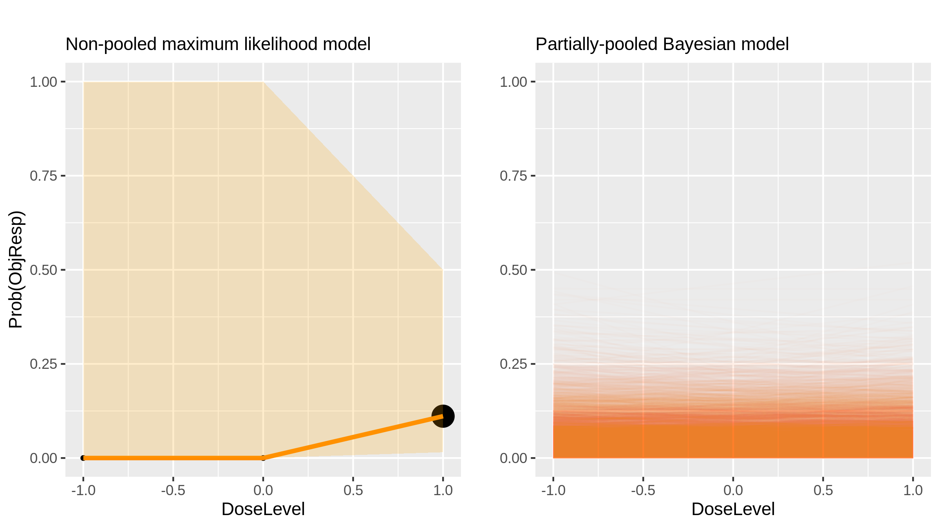
Buparlisib (Inhibitor) in Advanced Solid Tumours [Ando2014_1]

Slide 3
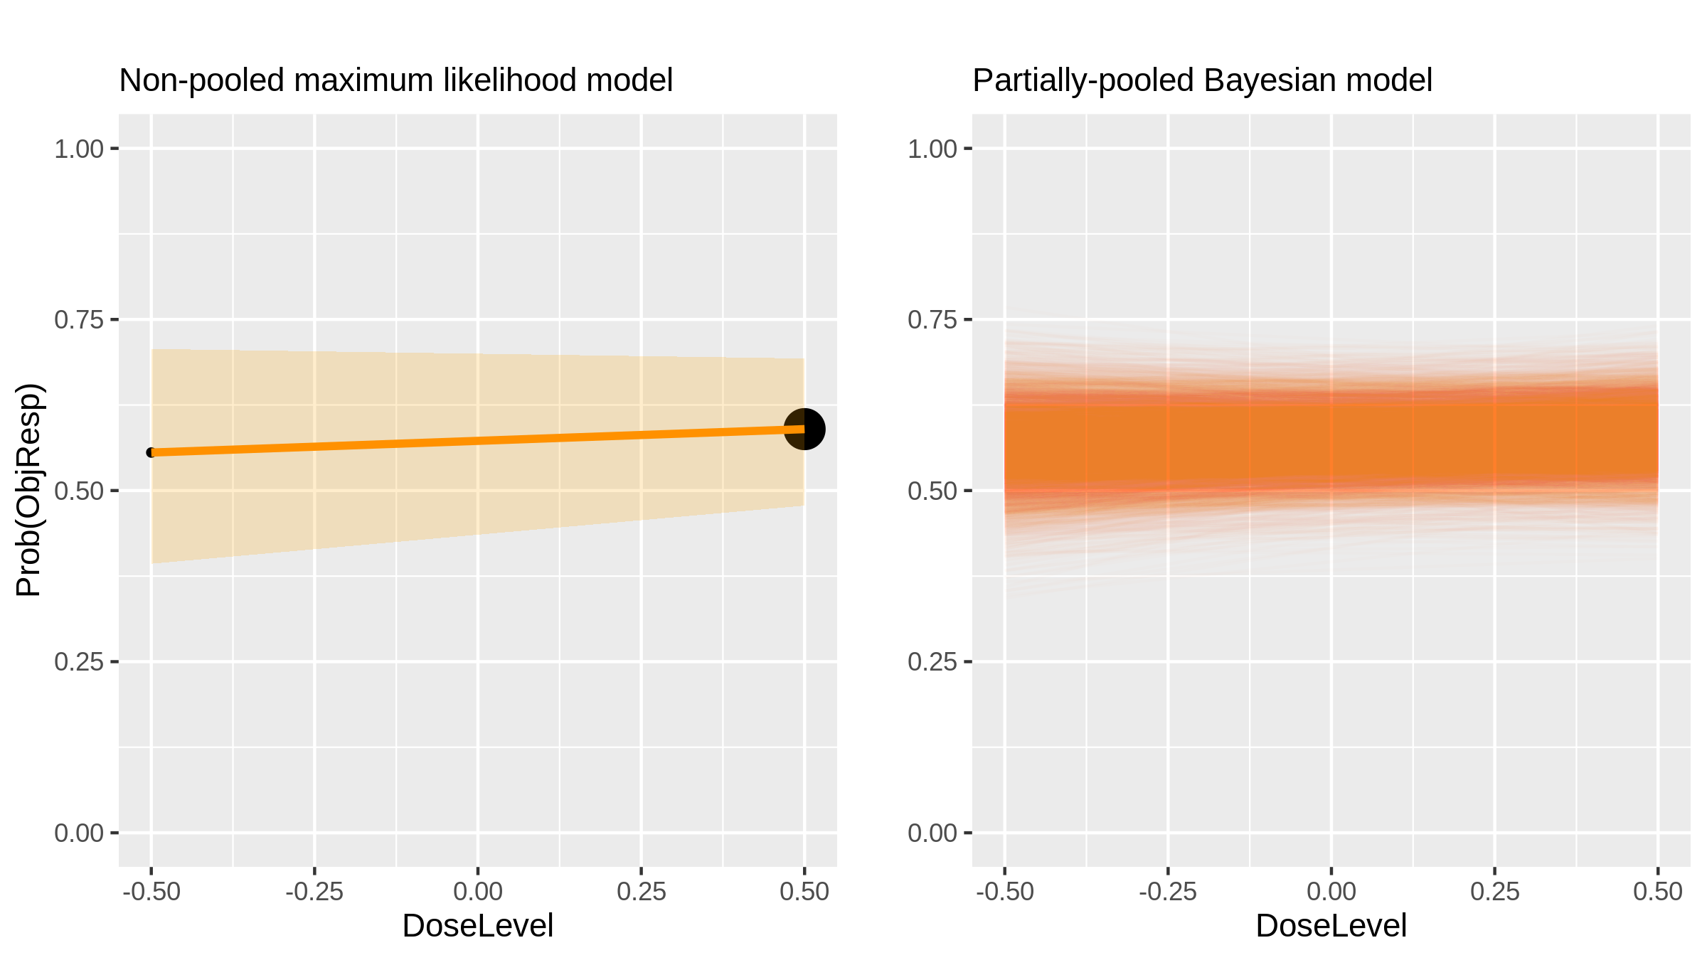
Ceritinib (Inhibitor) in Nsclc [Shaw2014_1]

Slide 4
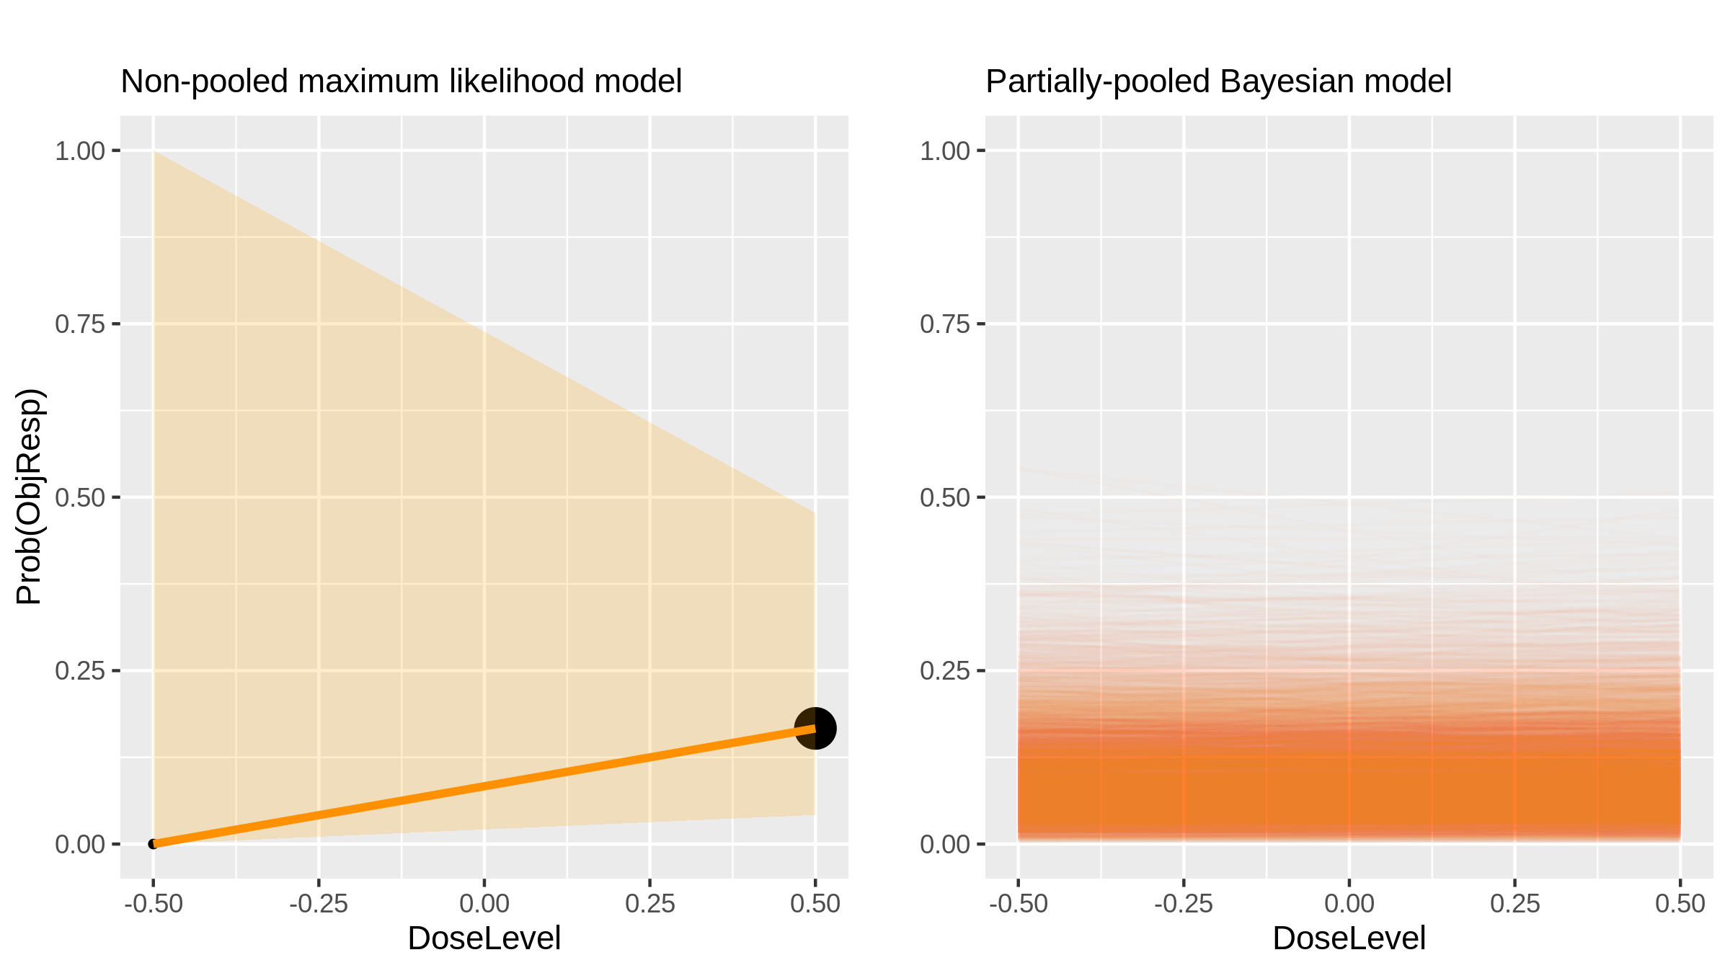
Buparlisib (Inhibitor) in Breast Cancer [Saura2014_1]

Slide 5
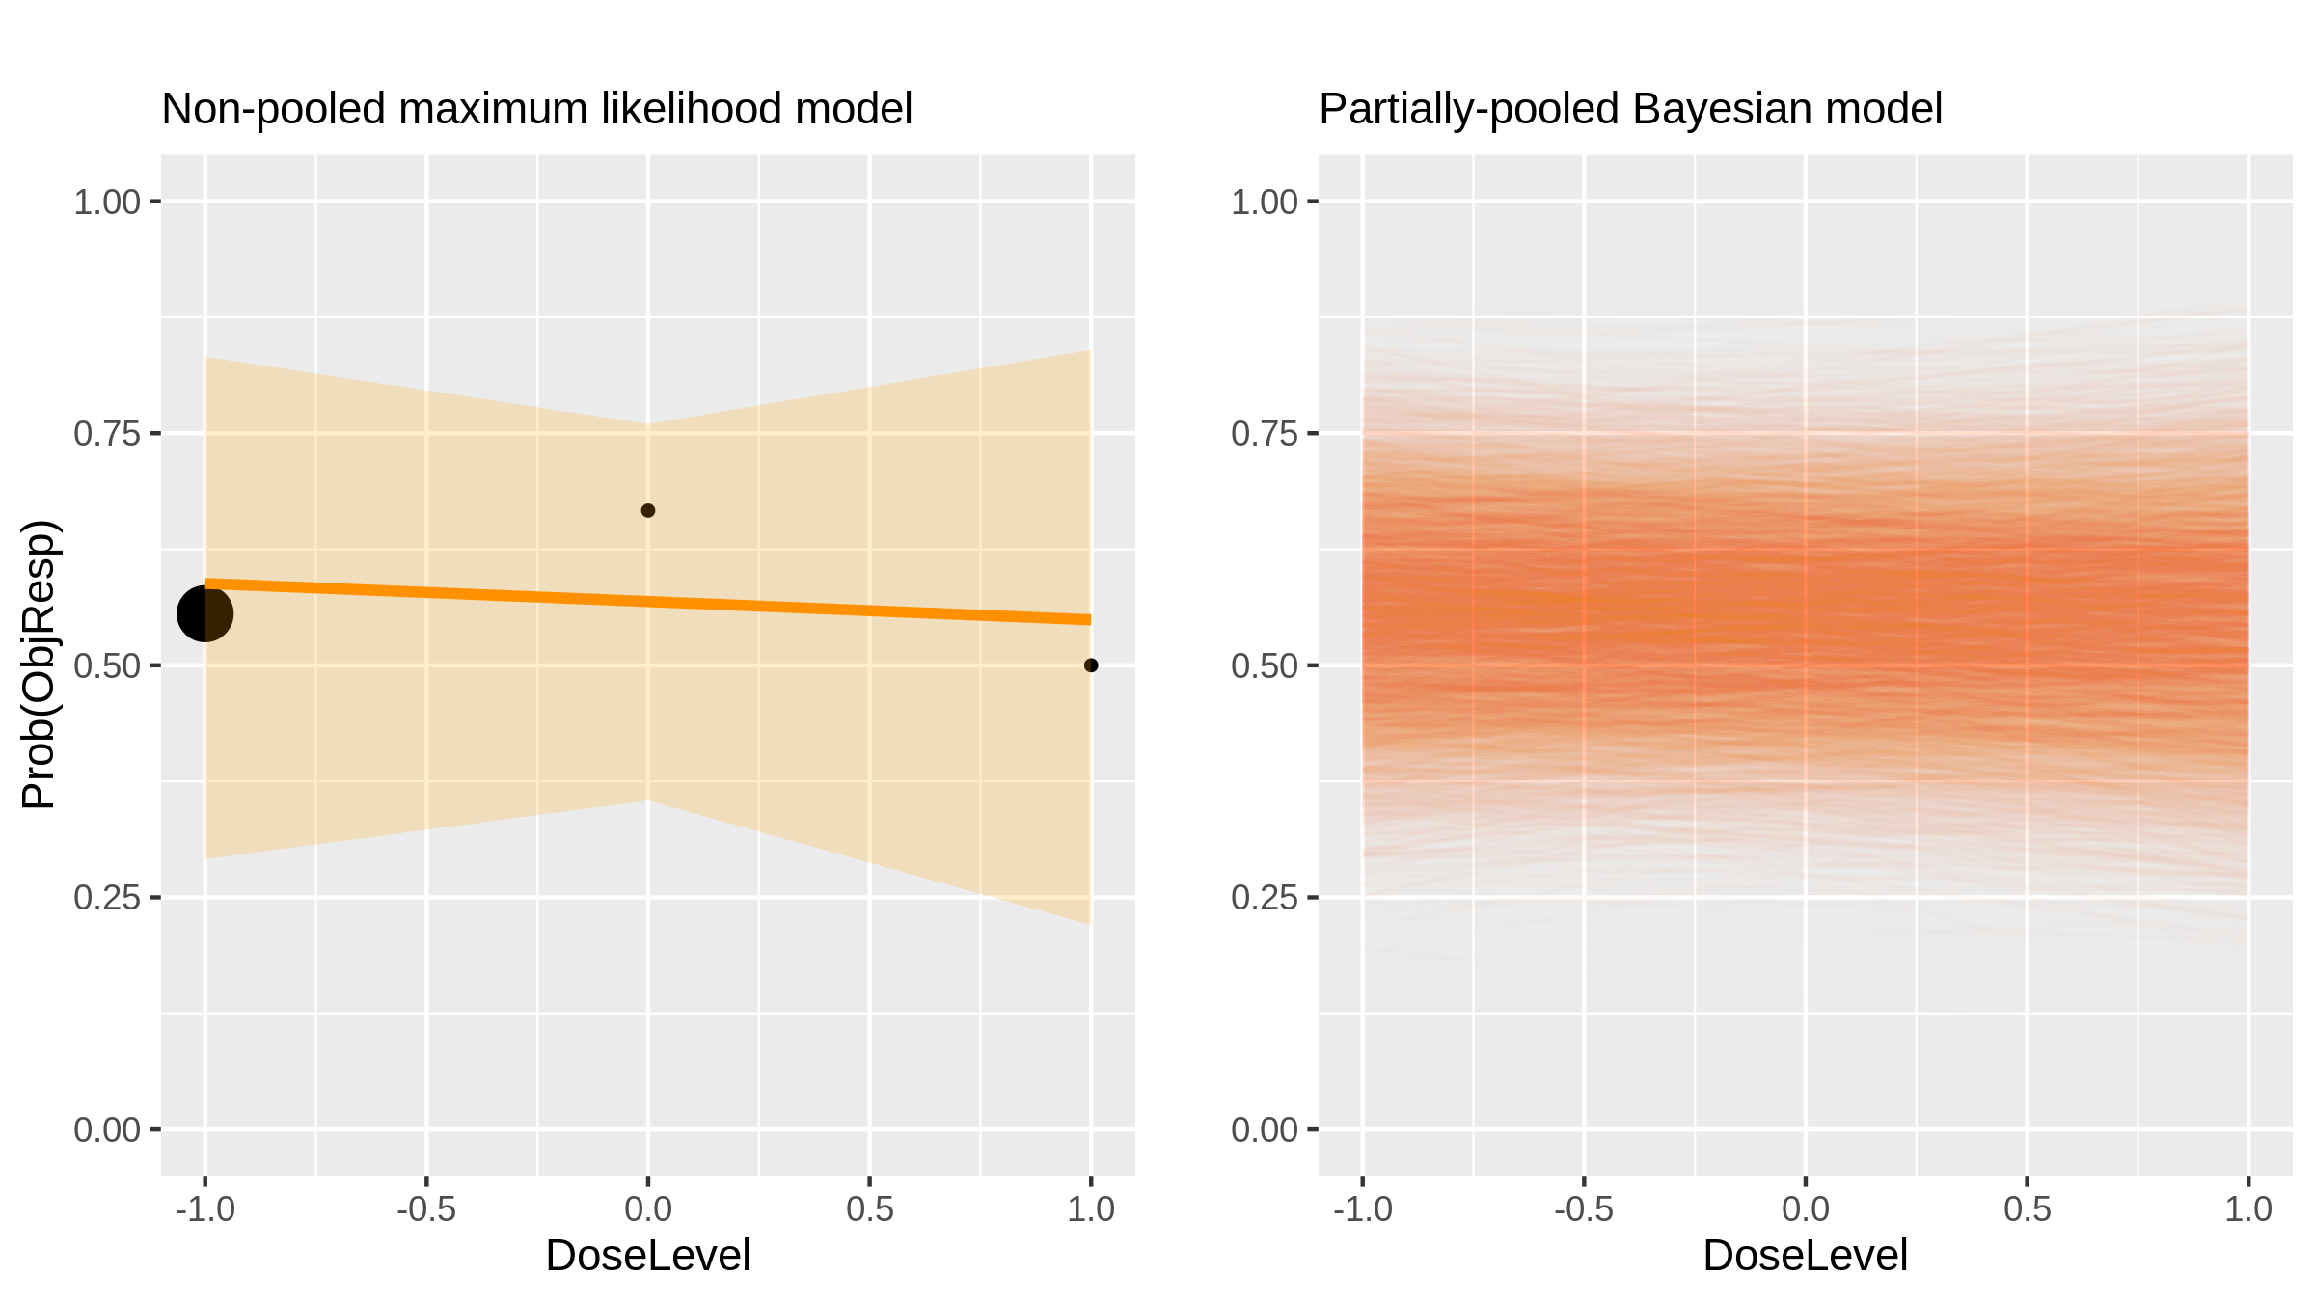
Idarubicin (Chemotherapy) in Hepatocellular Carcinoma [Boulin2014_1]

Slide 6
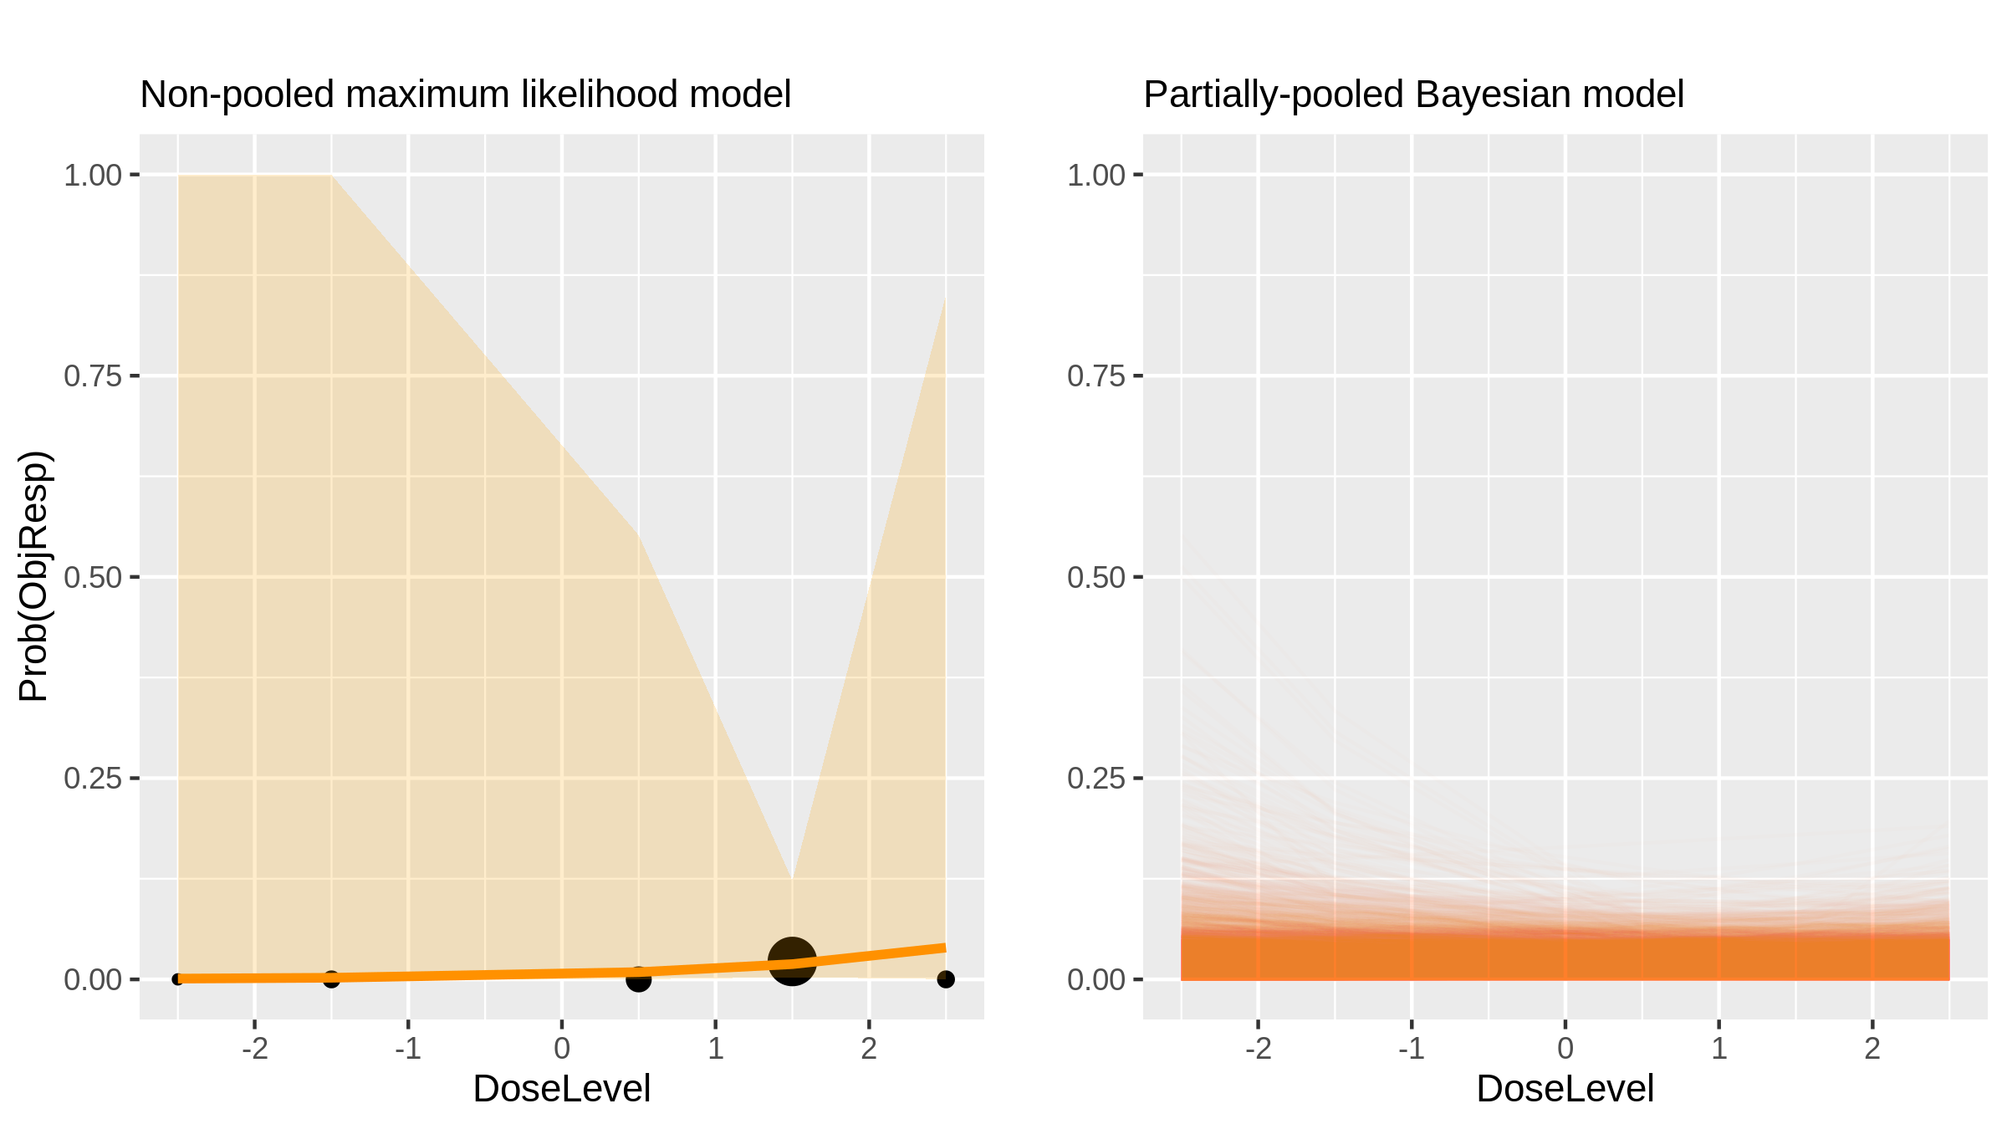
Buparlisib (Inhibitor) in Advanced Solid Tumours [Rodon2014b_1]

Slide 7
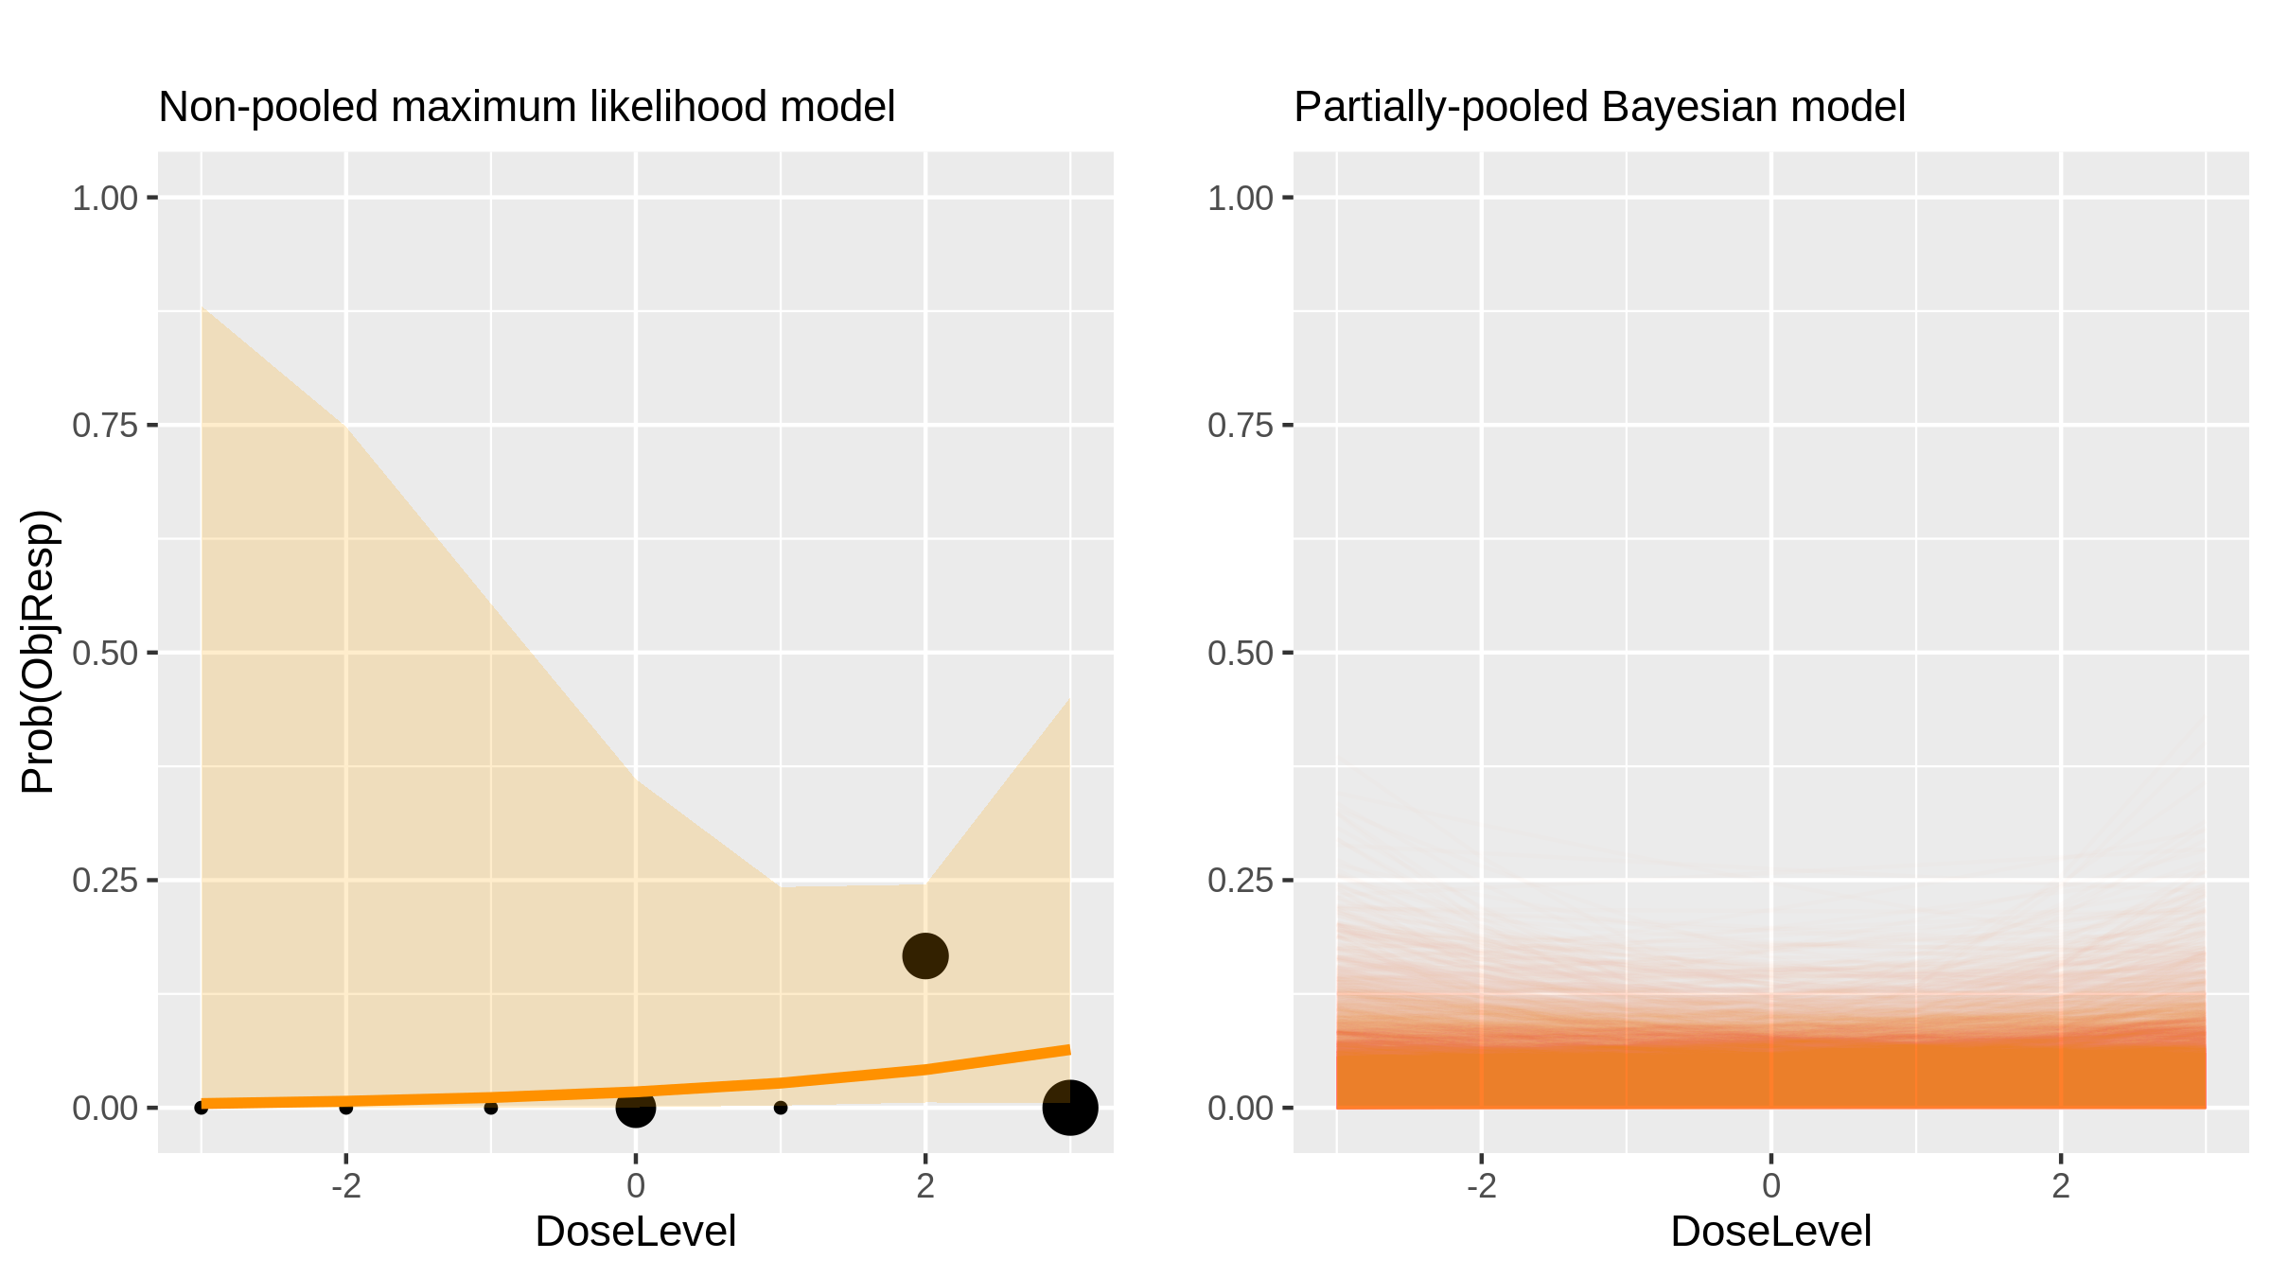
AUY922 (Inhibitor) in Advanced Solid Tumours [Doi2014_1]

Slide 8
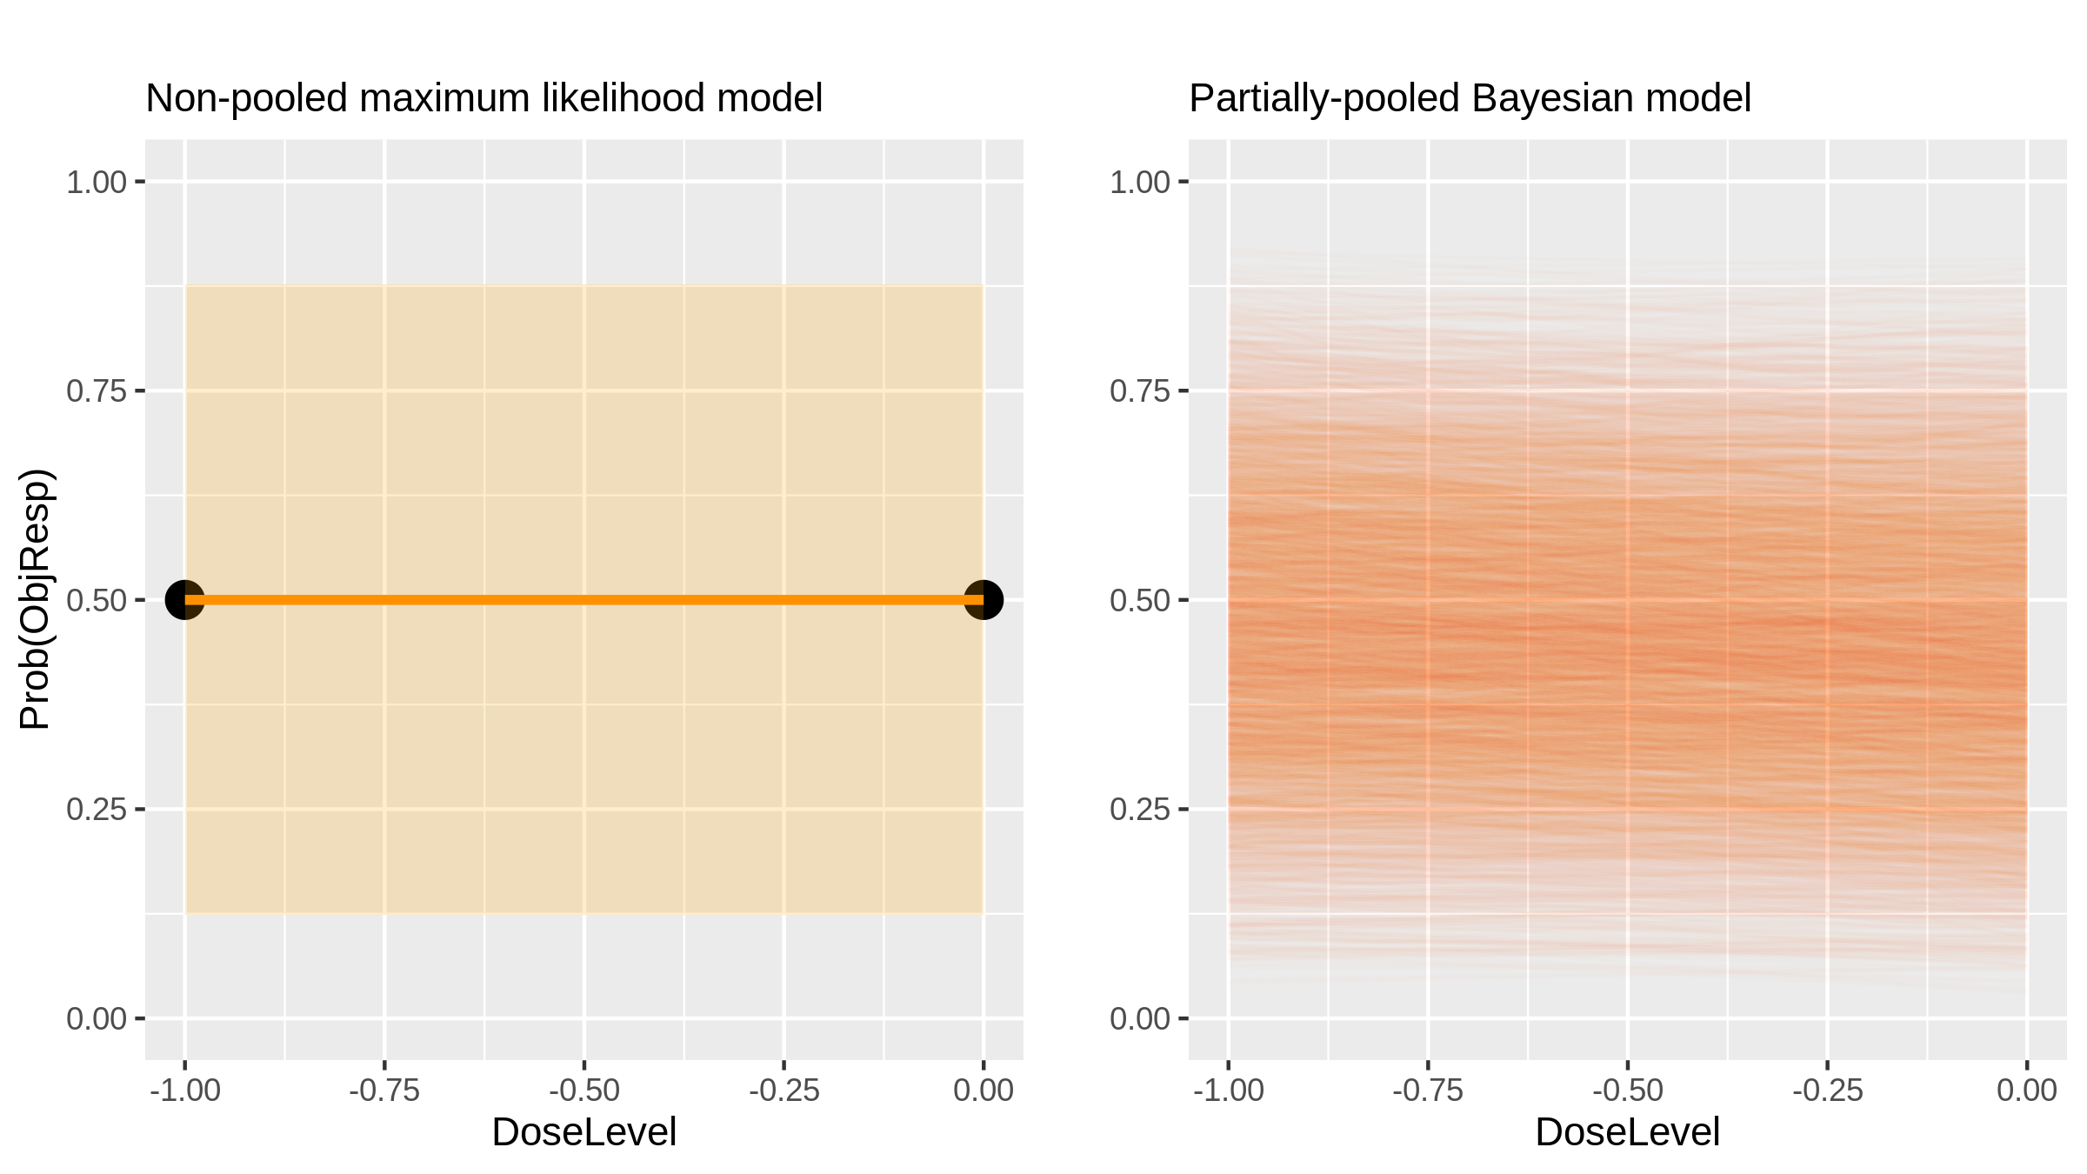
CD19-redirected virus-specific T cells (Cell therapy) in B-Cell Malignancies [Cruz2013_1]

Slide 9
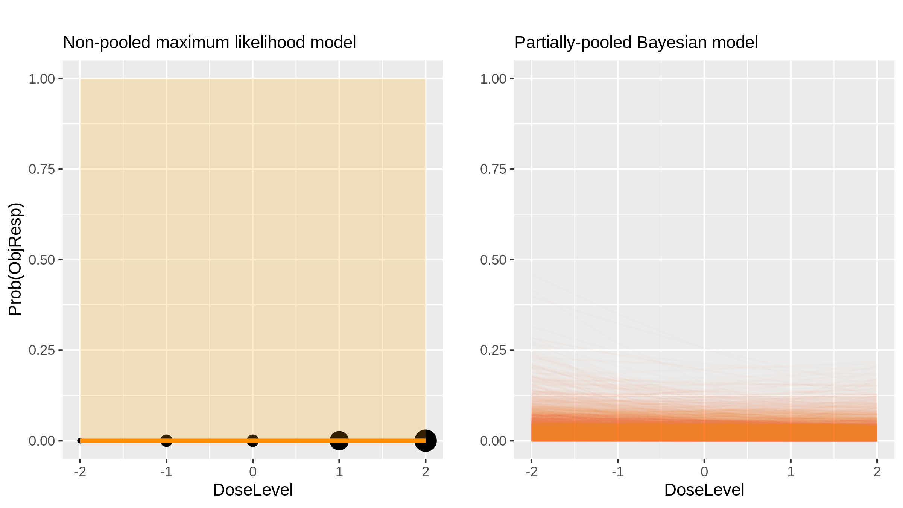
Panobinostat (Chemotherapy) in Lymphoma And Advanced Solid Tumours [Sharma2013_1]

Slide 10
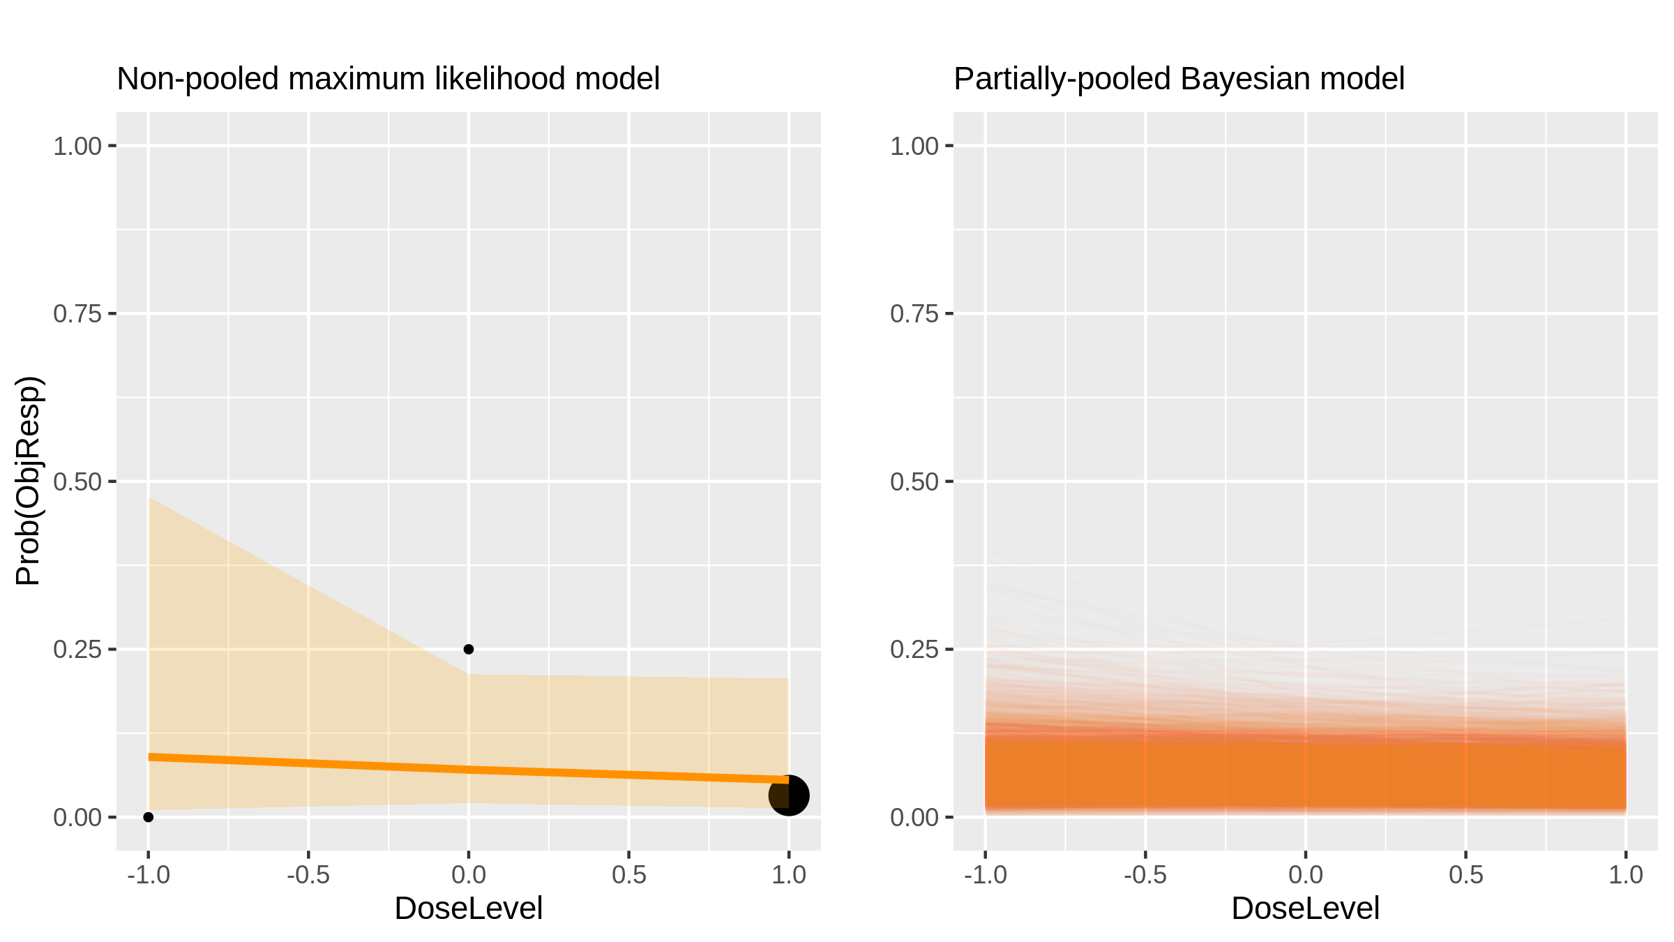
Panobinostat (Chemotherapy) in Lymphoma And Advanced Solid Tumours [Sharma2013_3]

Slide 11
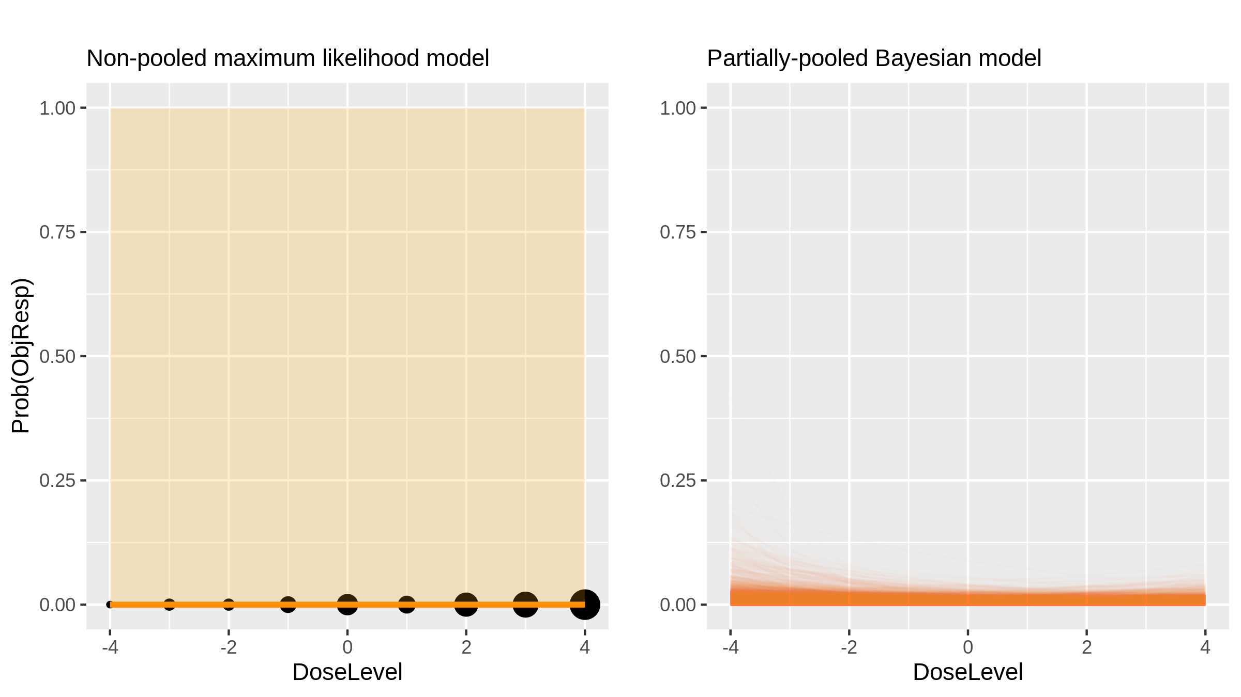
AUY922 (Inhibitor) in Advanced Solid Tumours [Sessa2013_1]

Slide 12
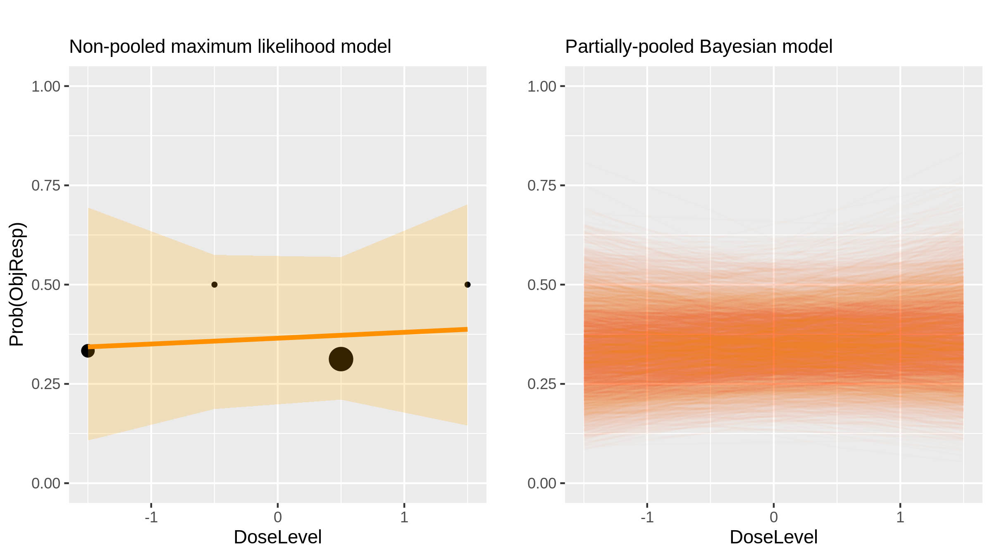
Gamma secretase inhibitors: MK-0752 (Inhibitor) in Breast Cancer [Schott2013_1]

Slide 13
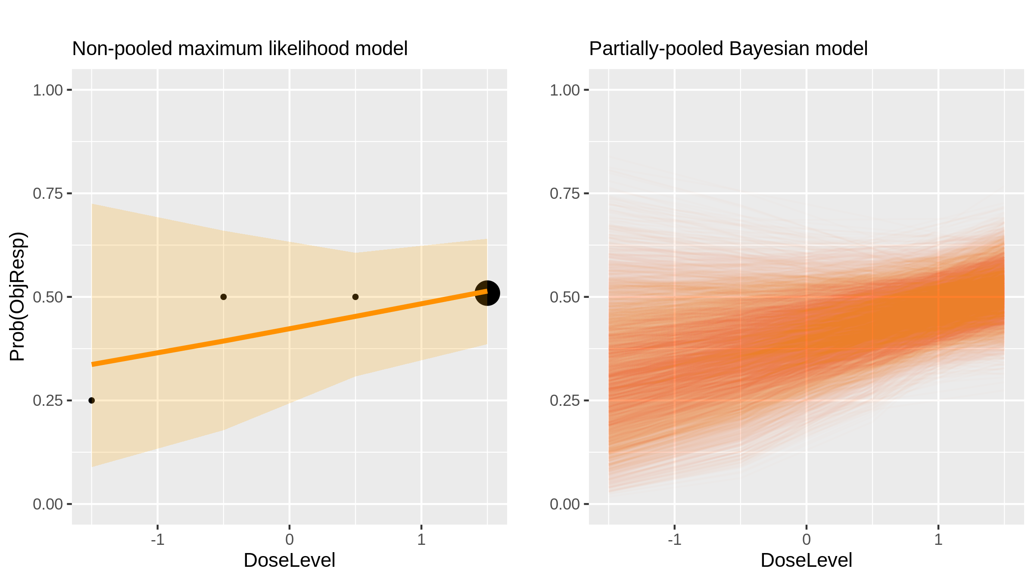
Pomalidomide (Immunomodulatory drug) in Multiple Myeloma [Larocca2013_1]

Slide 14
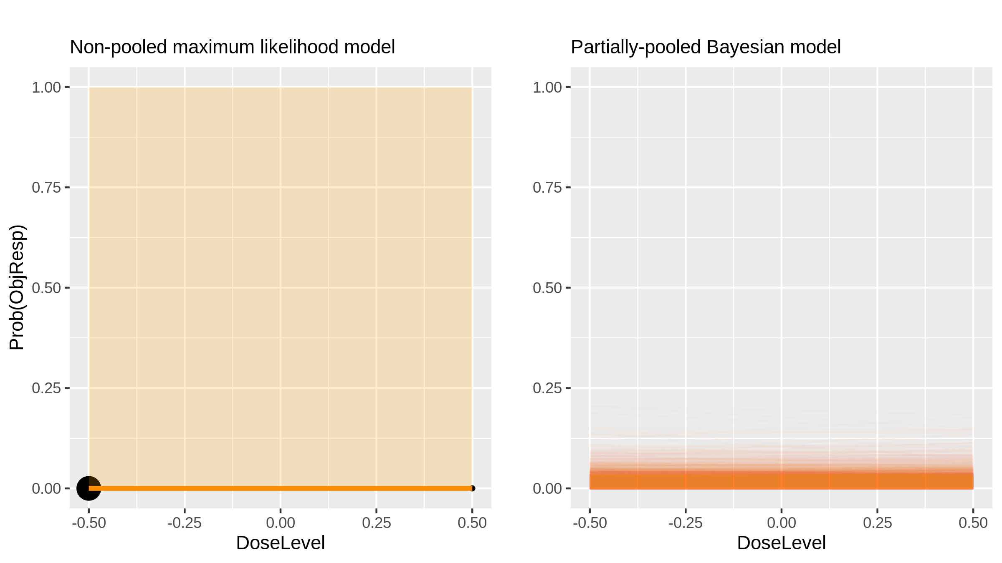
Everolimus (Inhibitor) in Hepatocellular Carcinoma [Finn2013_1]

Slide 15
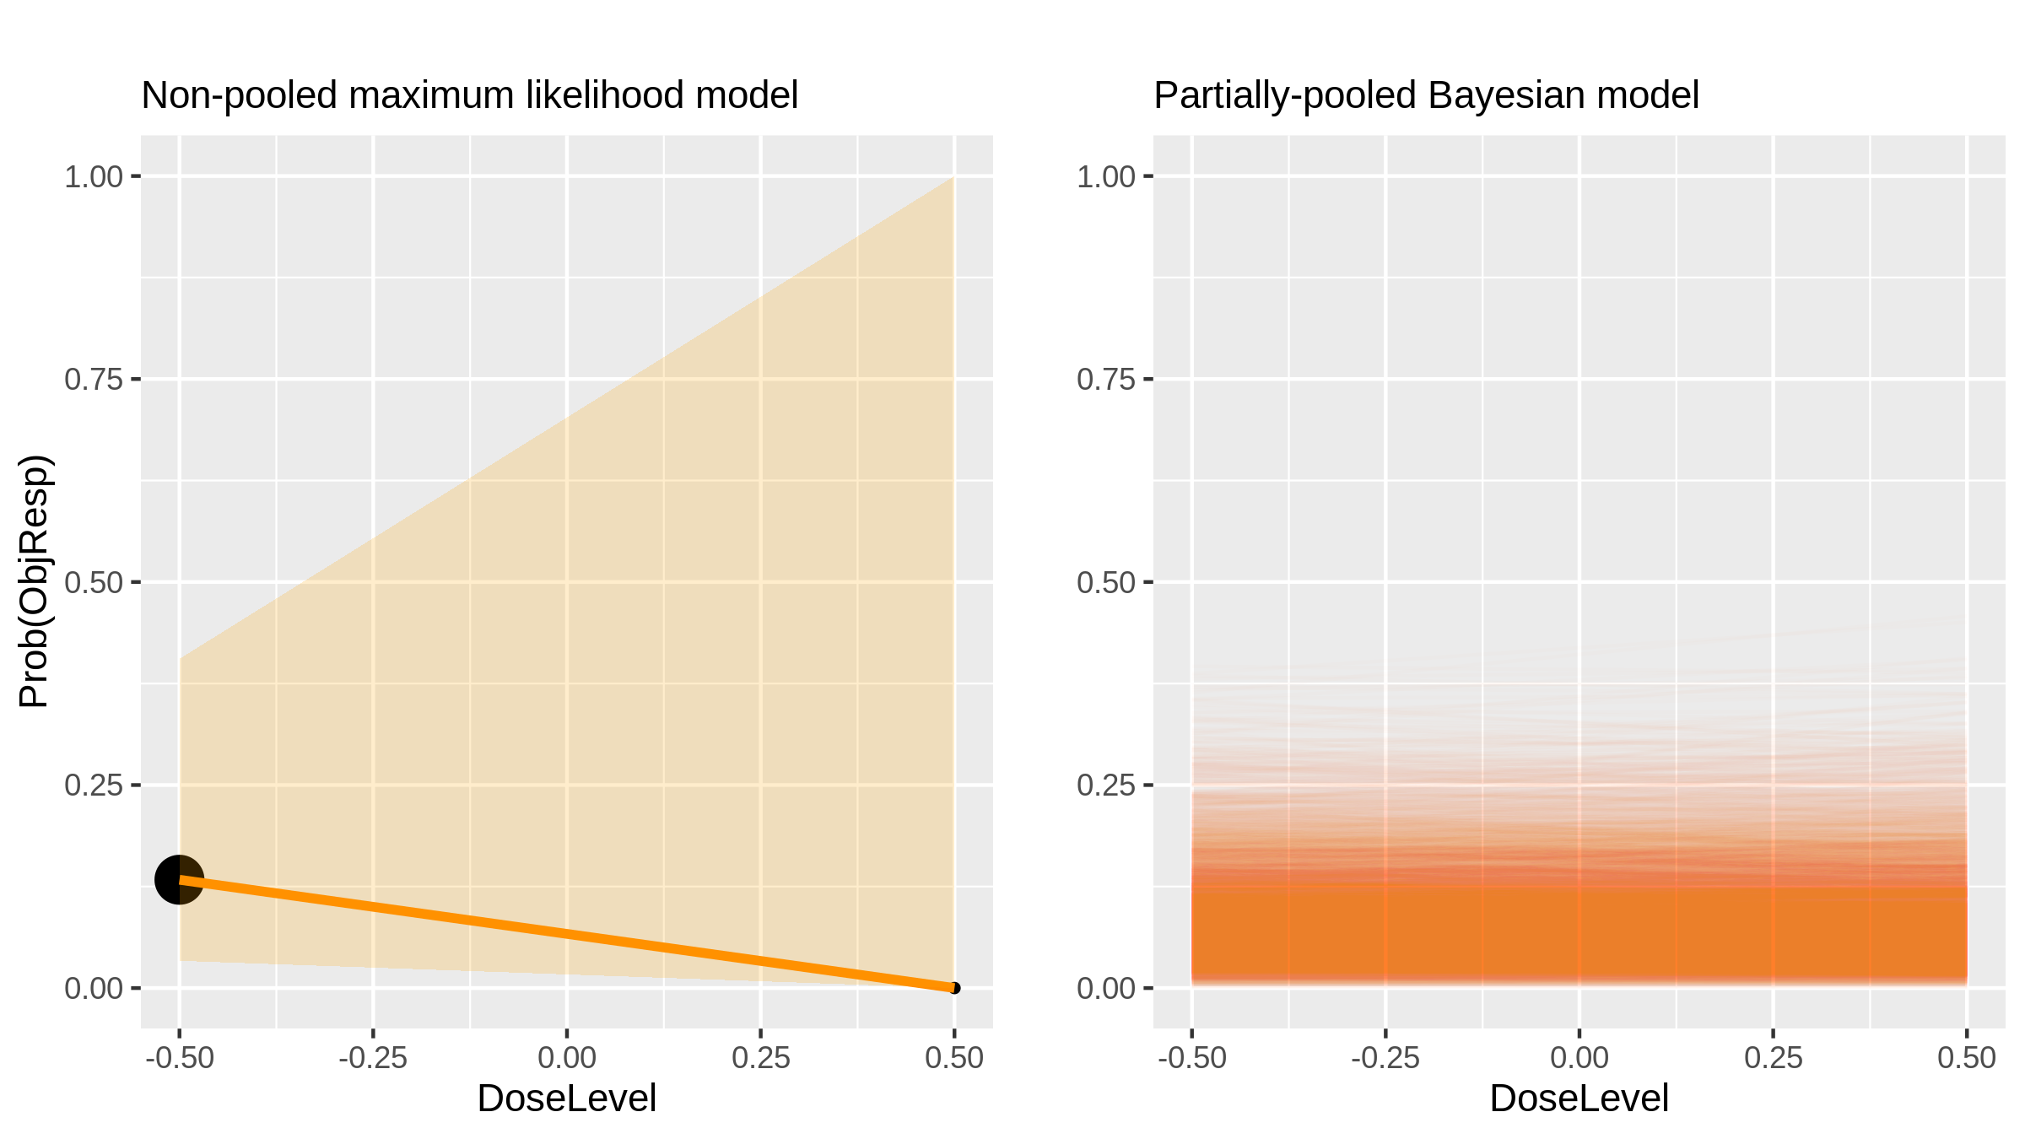
Dovitinib (Inhibitor) in Renal Cell Carcinoma [Angevin2013_1]

Slide 16
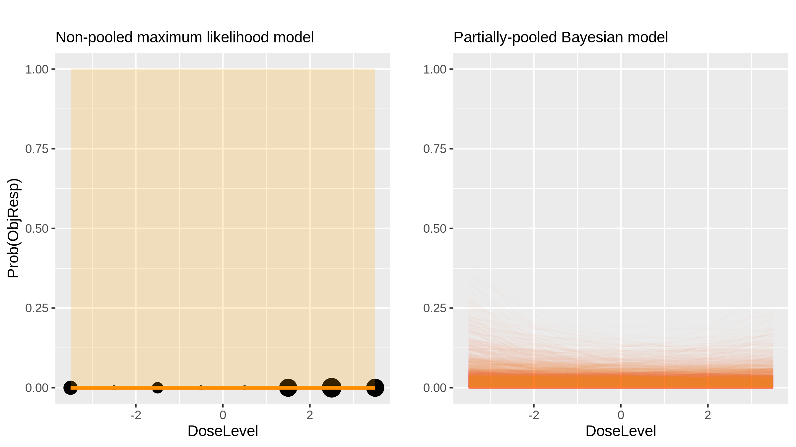
MKC-1 (Inhibitor) in Advanced Solid Tumours [Tevaarwek2012_1]

Slide 17
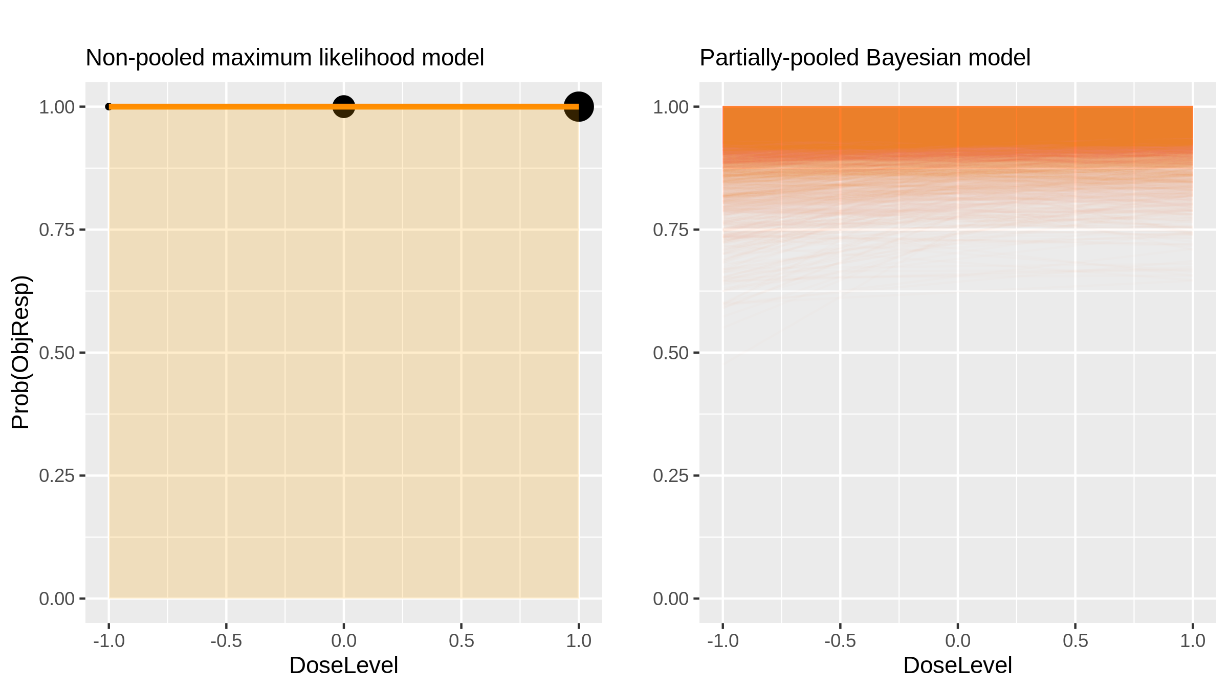
Bortezomib (Inhibitor) in Lymphoma [Sinha2012_1]

Slide 18
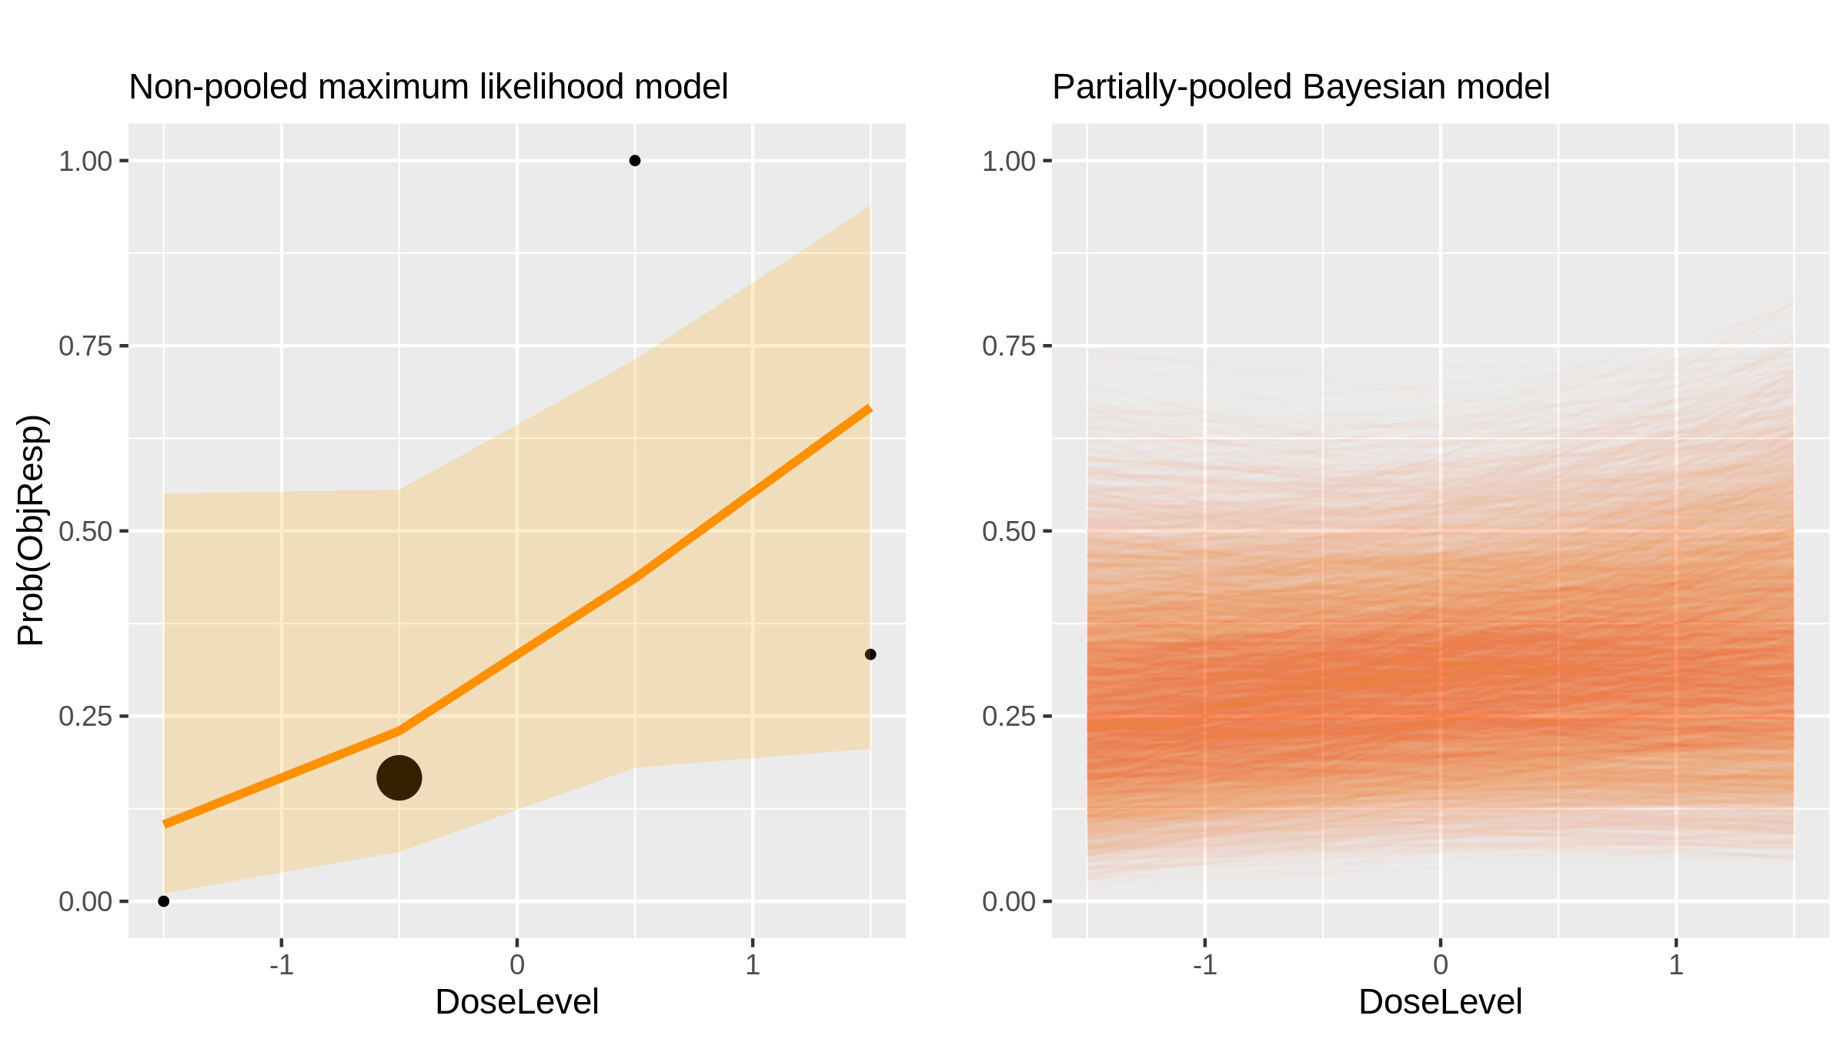
Navitoclax (Inhibitor) in Cll [Roberts2012_1]

Slide 19
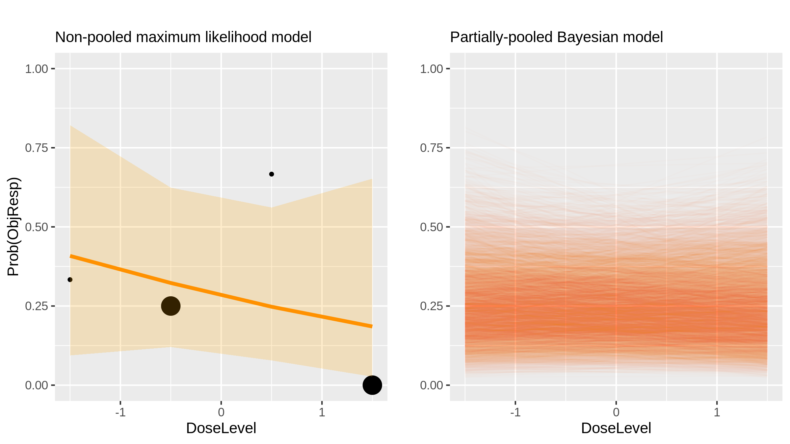
Navitoclax (Inhibitor) in Cll [Roberts2012_2]

Slide 20
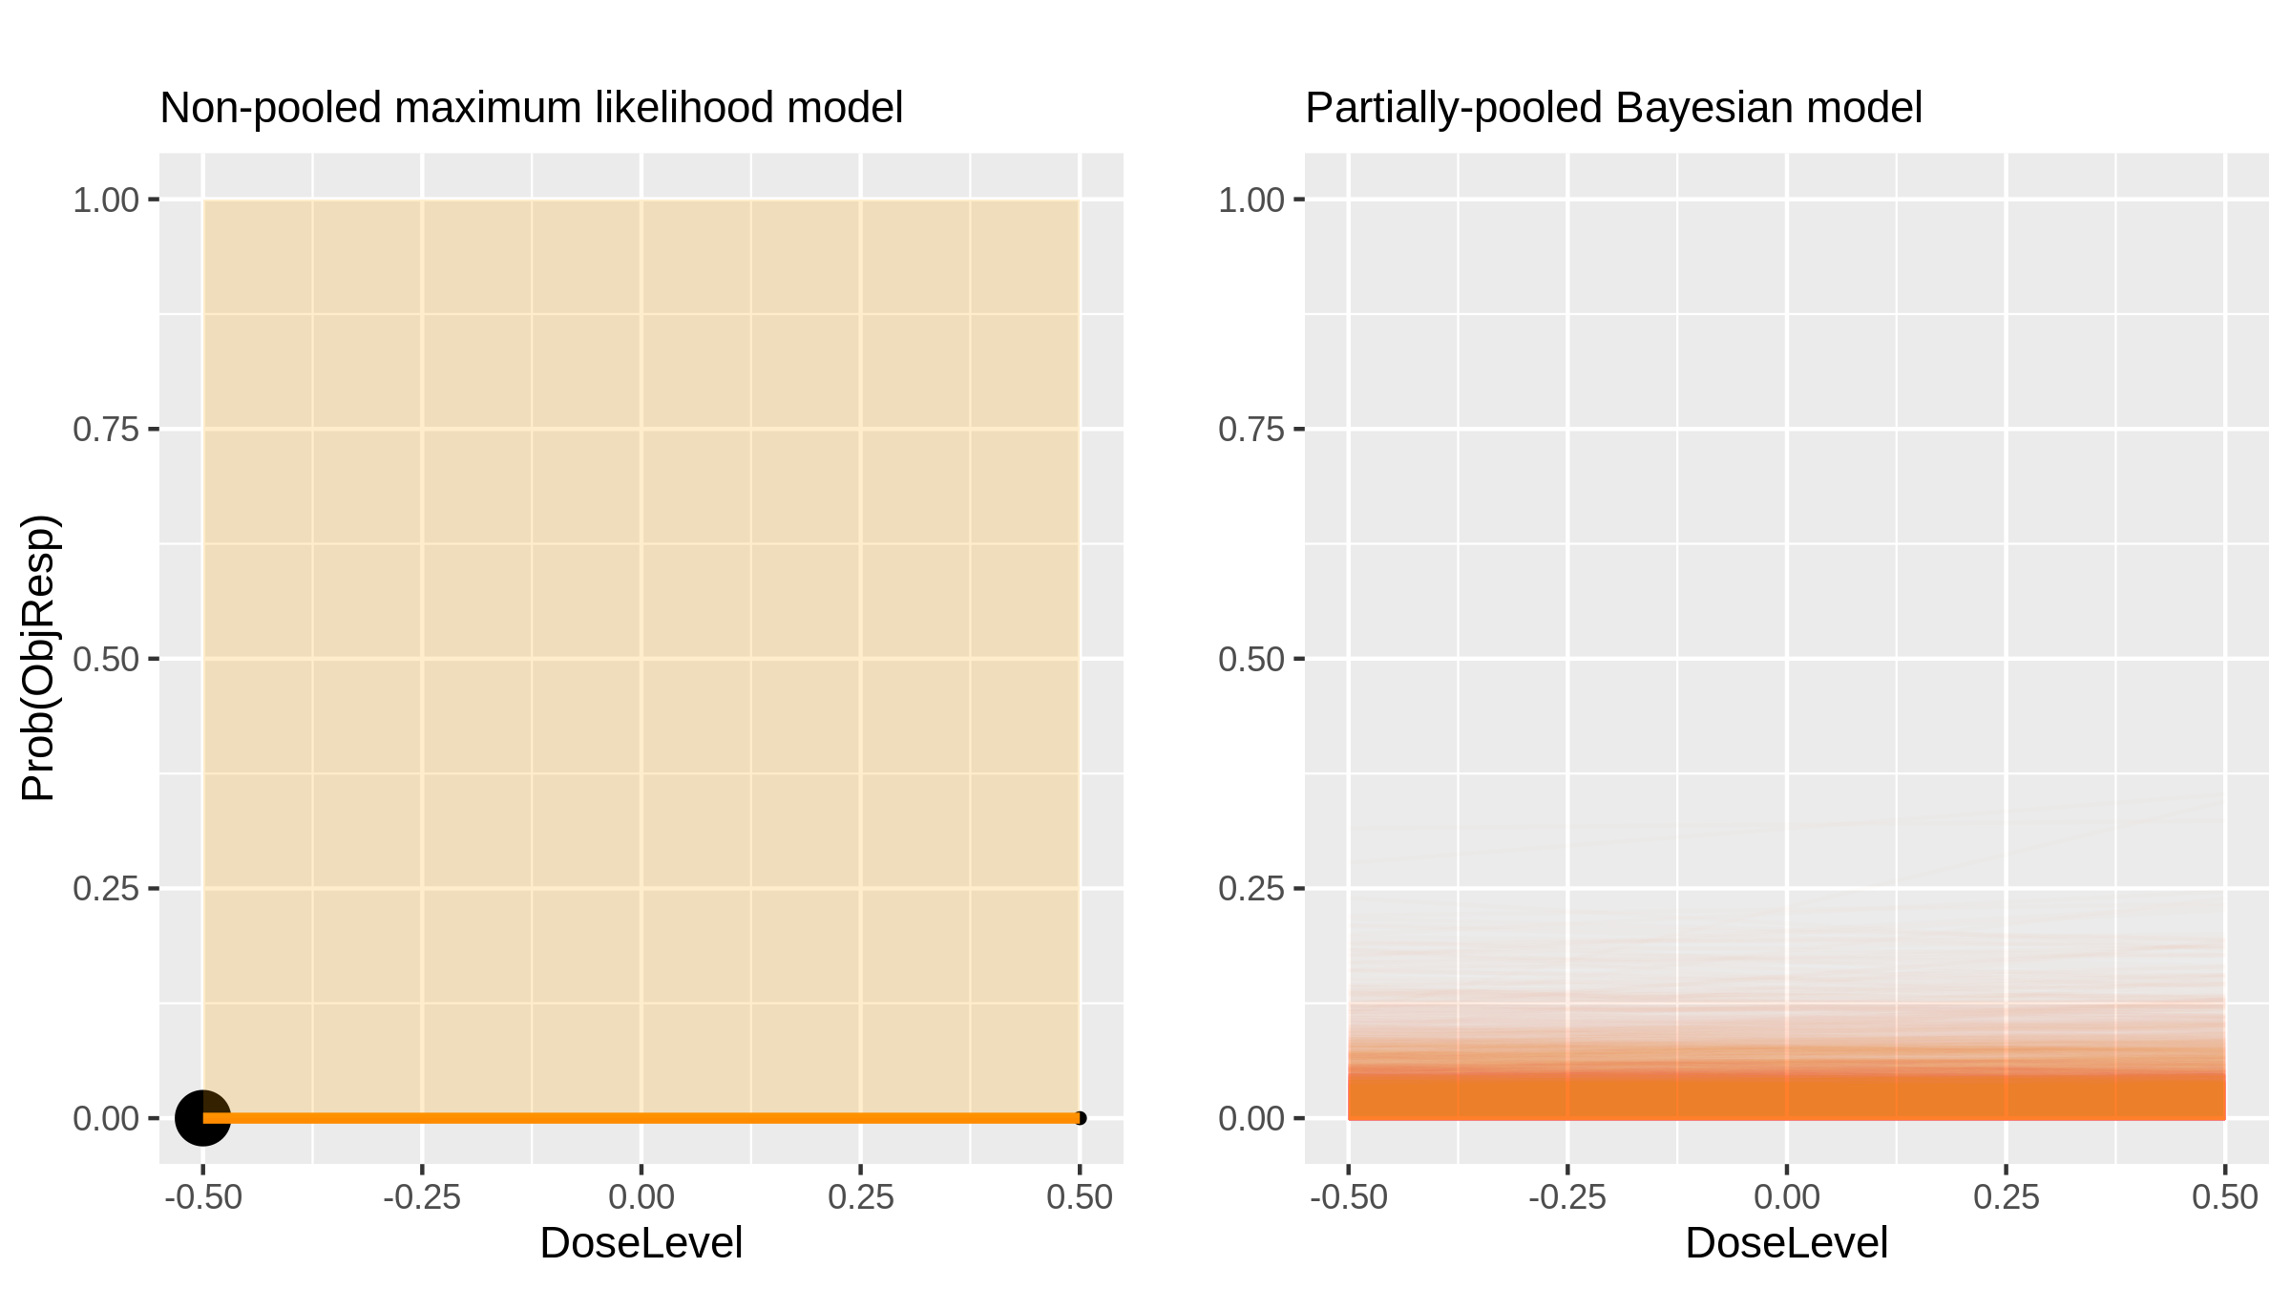
AEE788 (Inhibitor) in Glioblastoma [Reardon2012_1]

Slide 21
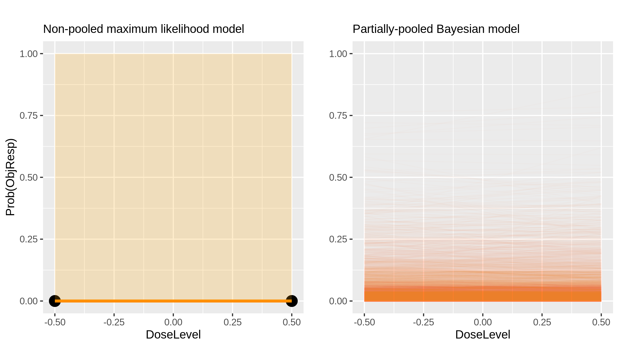
Everolimus + docetaxel (Chemotherapy + Inhibitor) in Breast Cancer [Moulder2012_1]

Slide 22
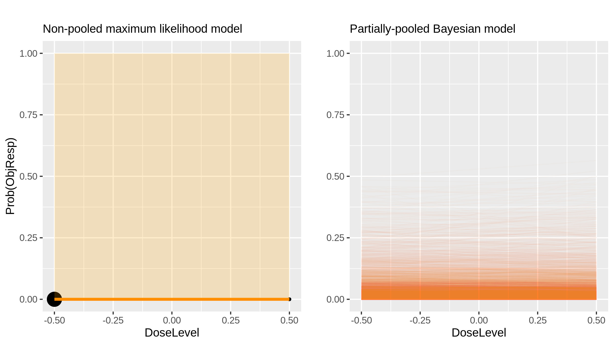
Everolimus + docetaxel (Chemotherapy + Inhibitor) in Breast Cancer [Moulder2012_1]

Slide 23
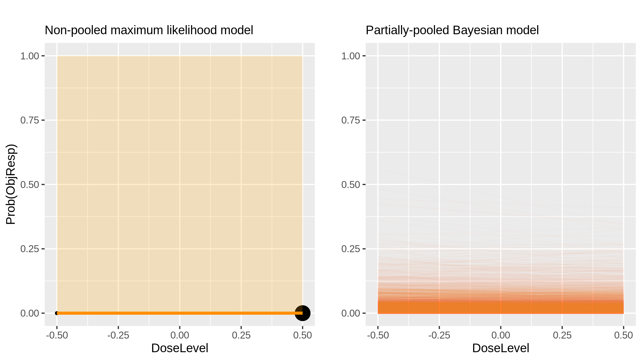
Everolimus + docetaxel (Chemotherapy + Inhibitor) in Breast Cancer [Moulder2012_1]

Slide 24
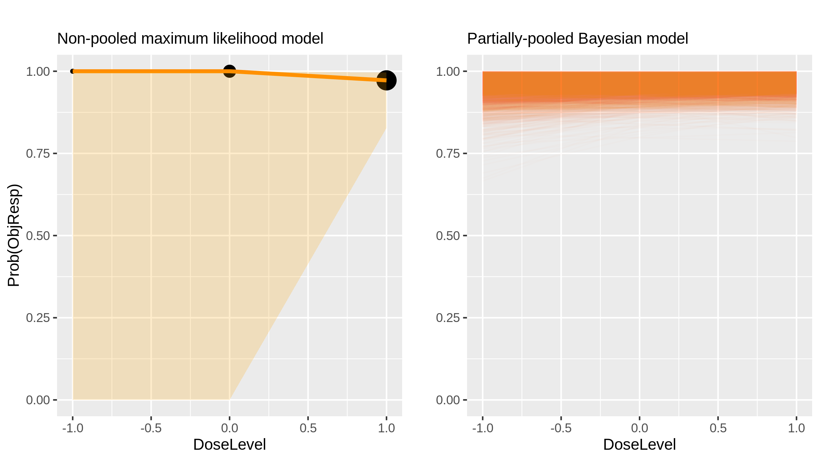
Carfilzomib (Inhibitor) in Multiple Myeloma [Jakubowiak2012_1]

Slide 25
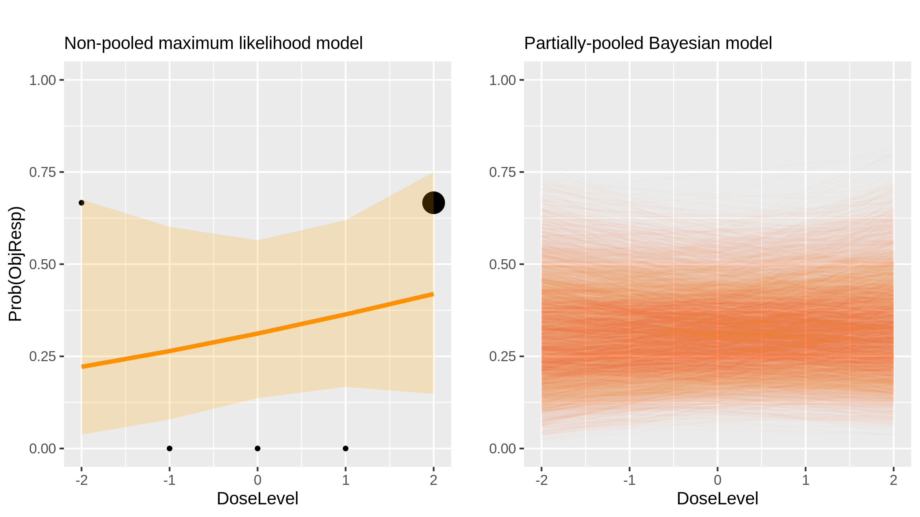
Capecitabine (Chemotherapy) in Colorectal Cancer [Farid2012_1]

Slide 26
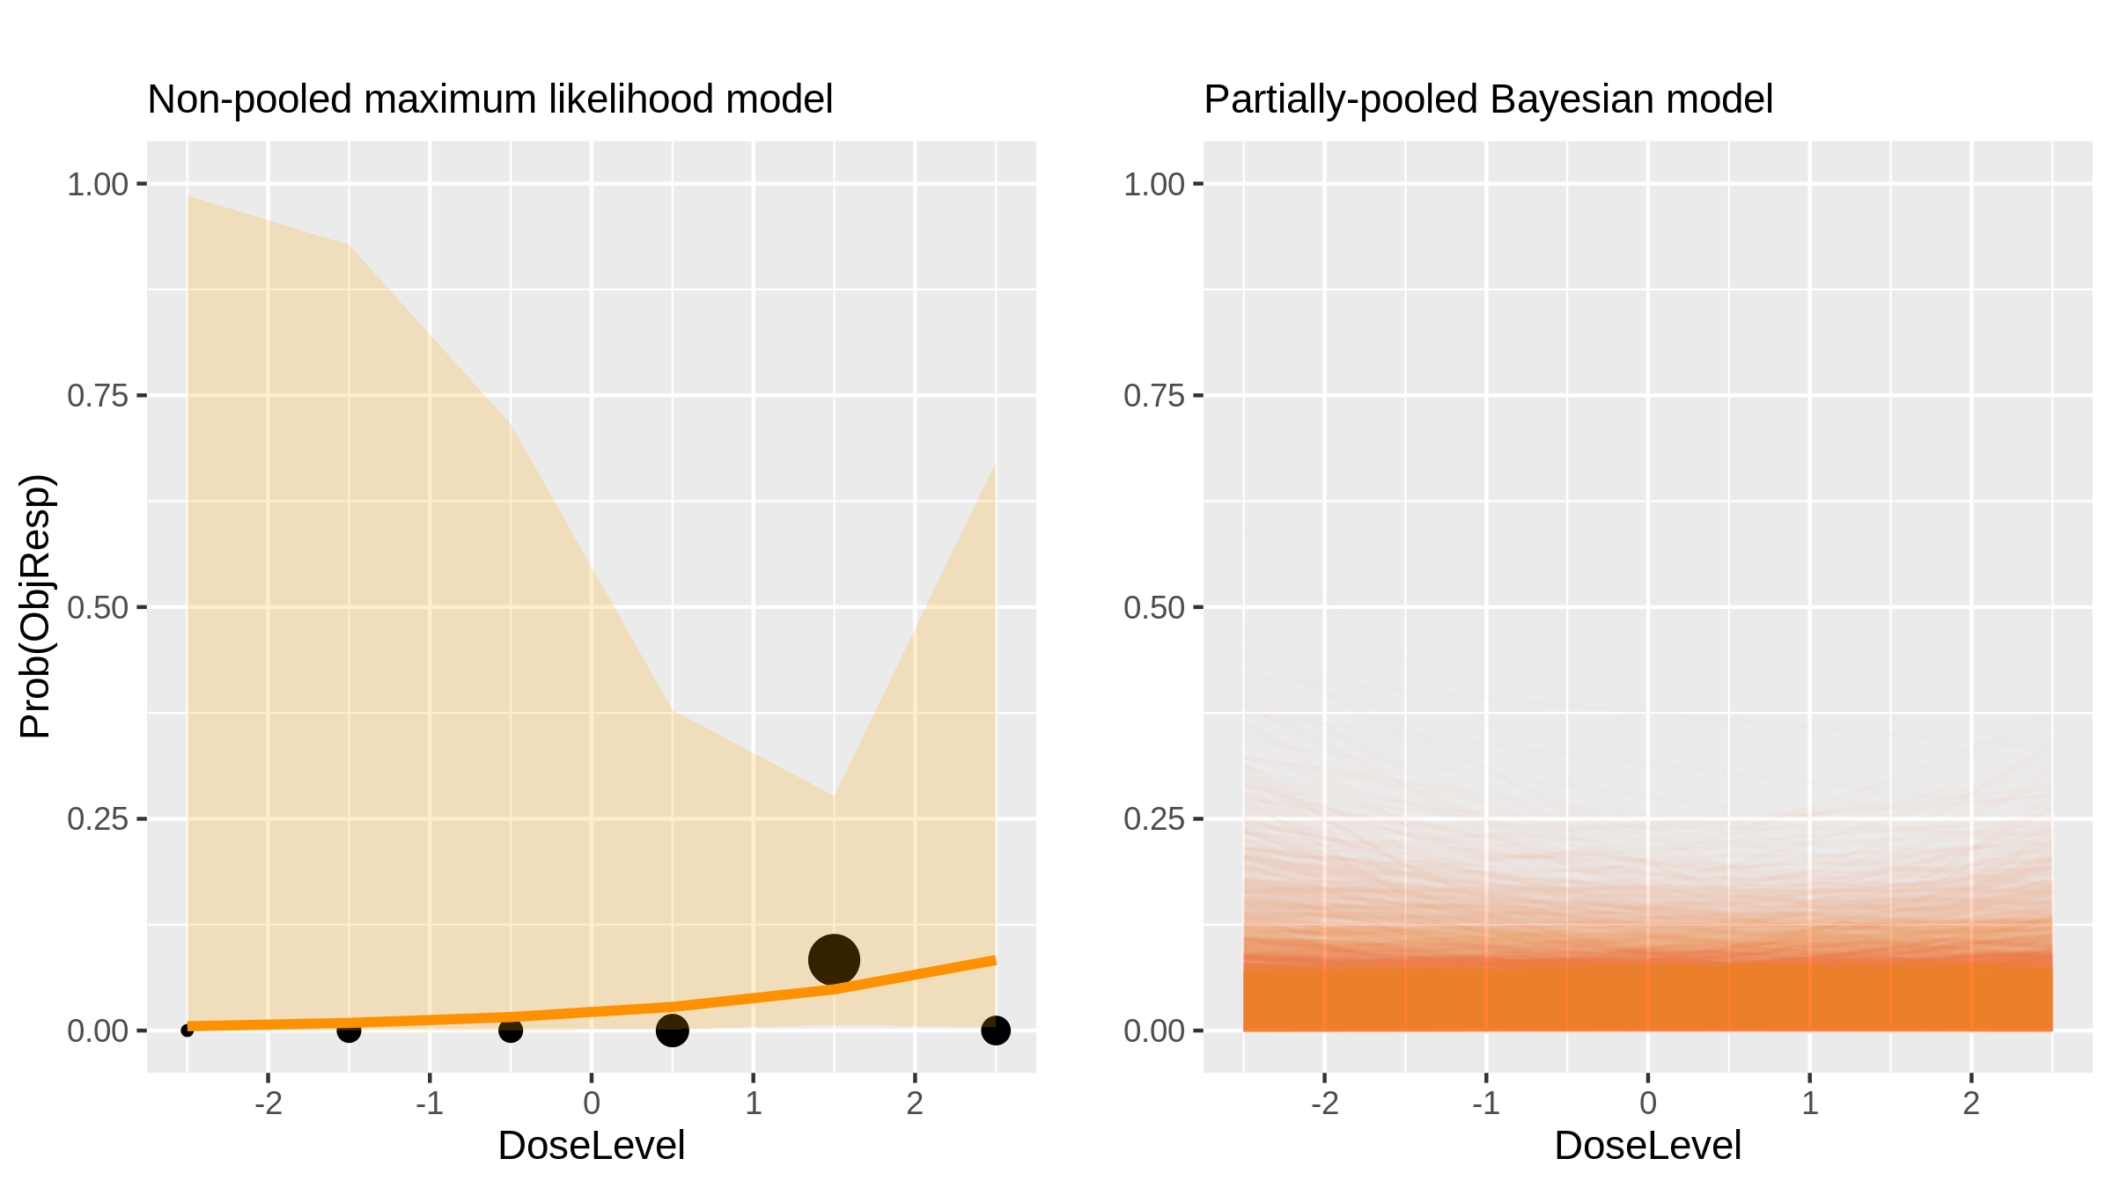
BKM120 (Inhibitor) in Advanced Solid Tumours [Bendell2012_1]

Slide 27
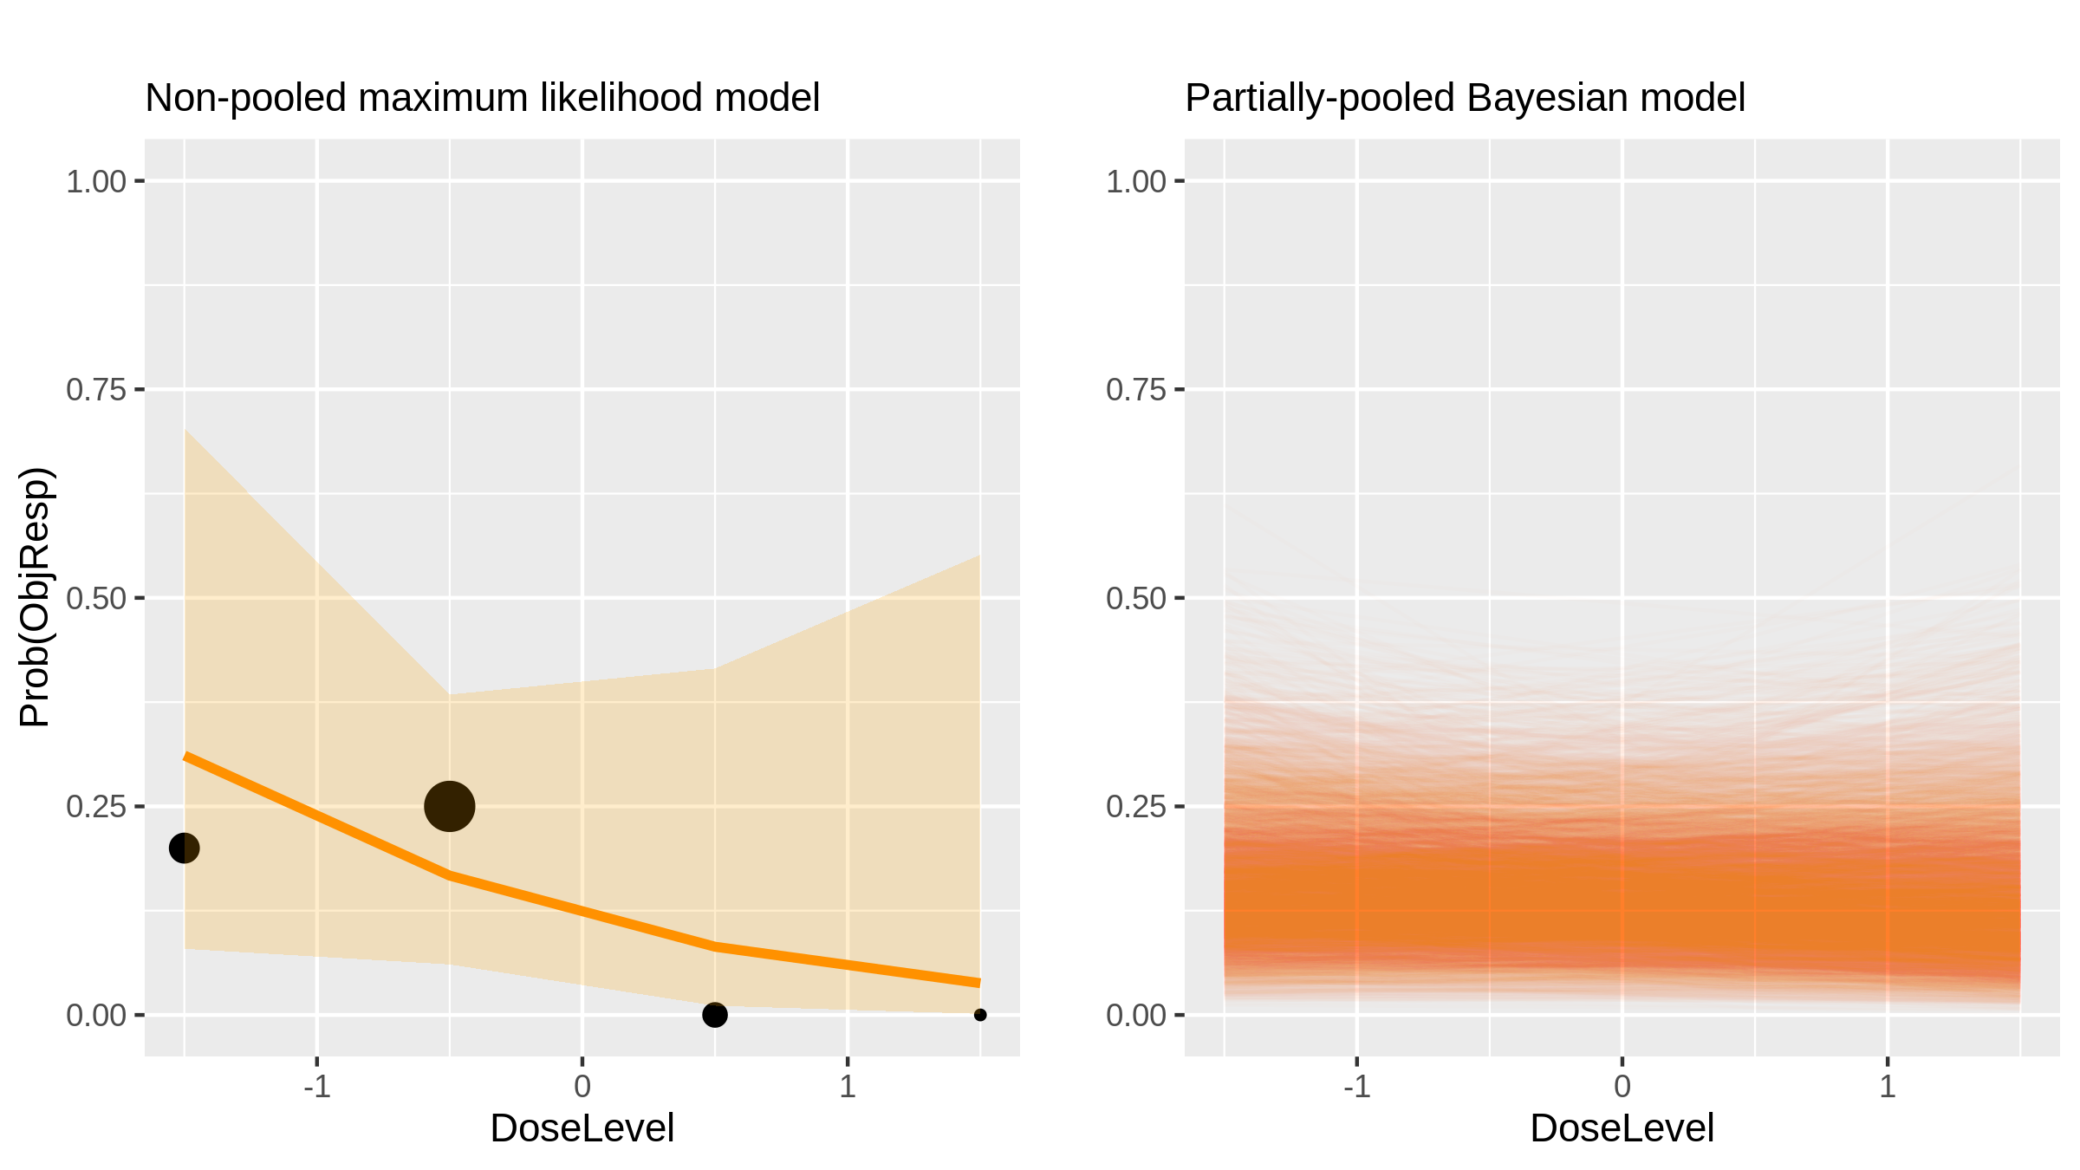
Everolimus (Inhibitor) in Nsclc [Vansteenkist2011_1]

Slide 28
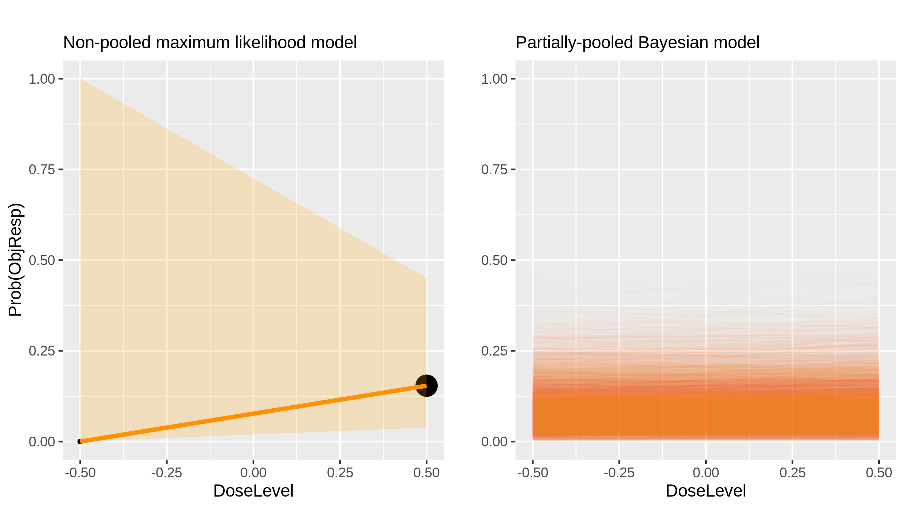
Everolimus (Inhibitor) in Nsclc [Vansteenkist2011_2]

Slide 29
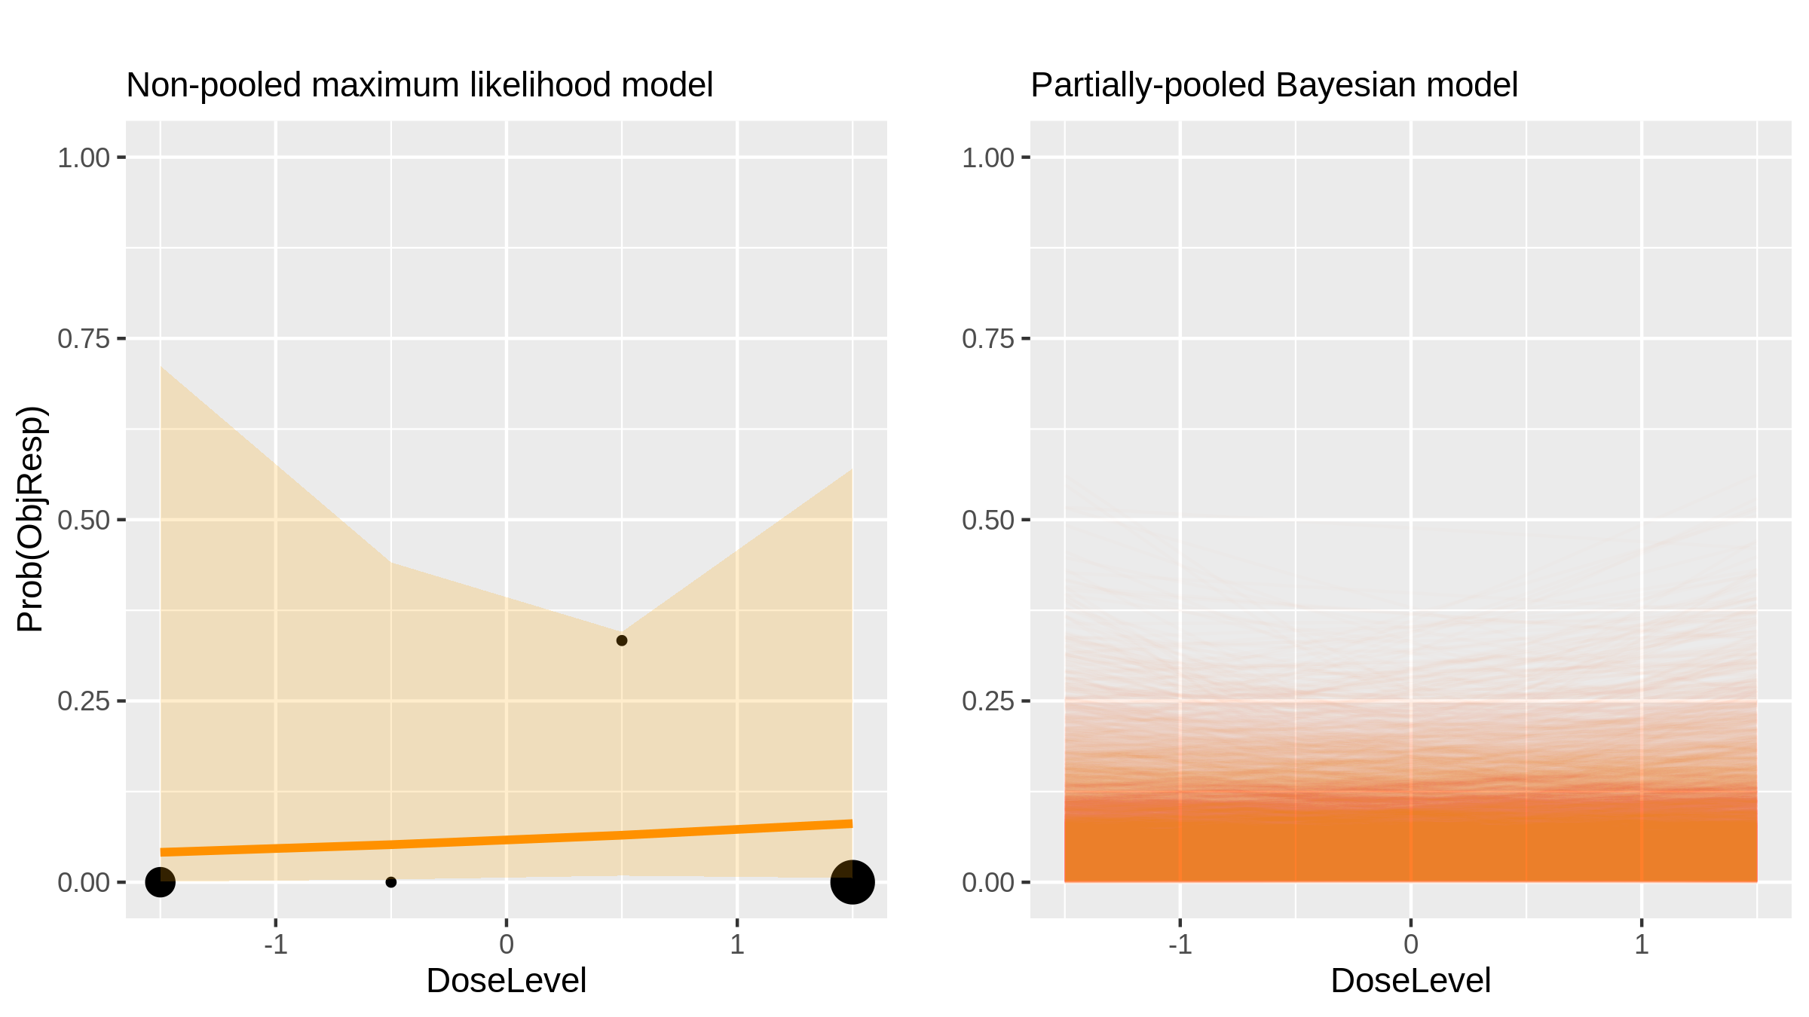
Paclitaxel + bortezomib (Chemotherapy + inhibitor) in Advanced Solid Tumours [Mehnert2011_1]

Slide 30
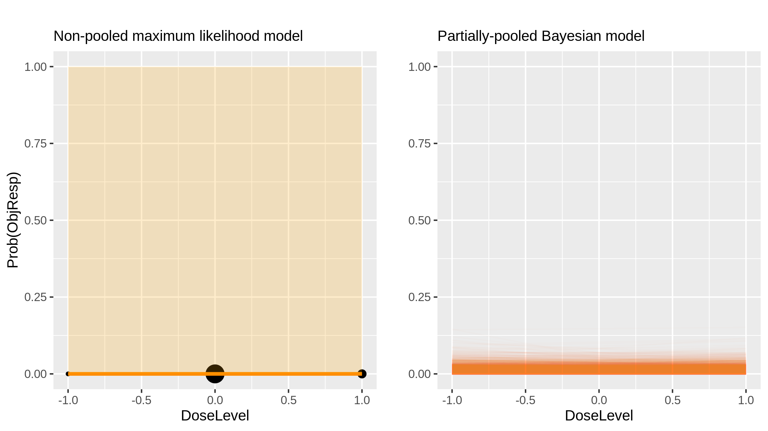
Dovitinib (Inhibitor) in Melanoma [Kim2011_1]

Slide 31
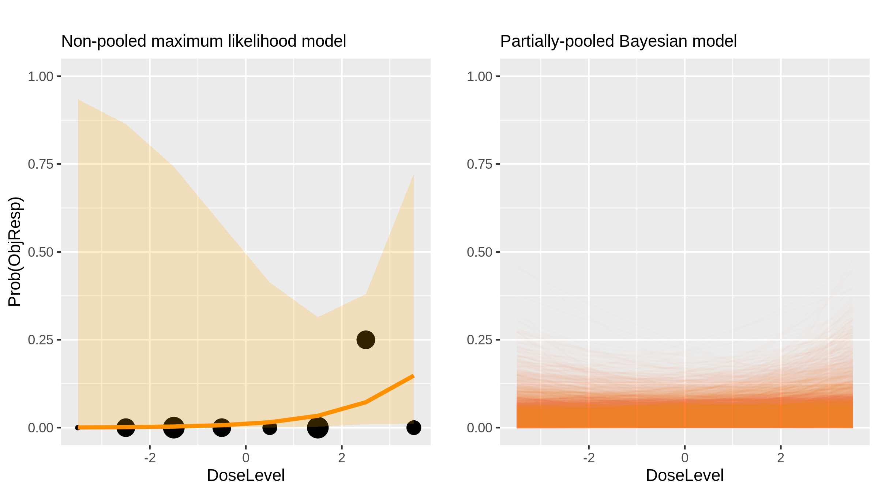
Navitoclax (Inhibitor) in Sclc [Gandhi2011_1]

Slide 32
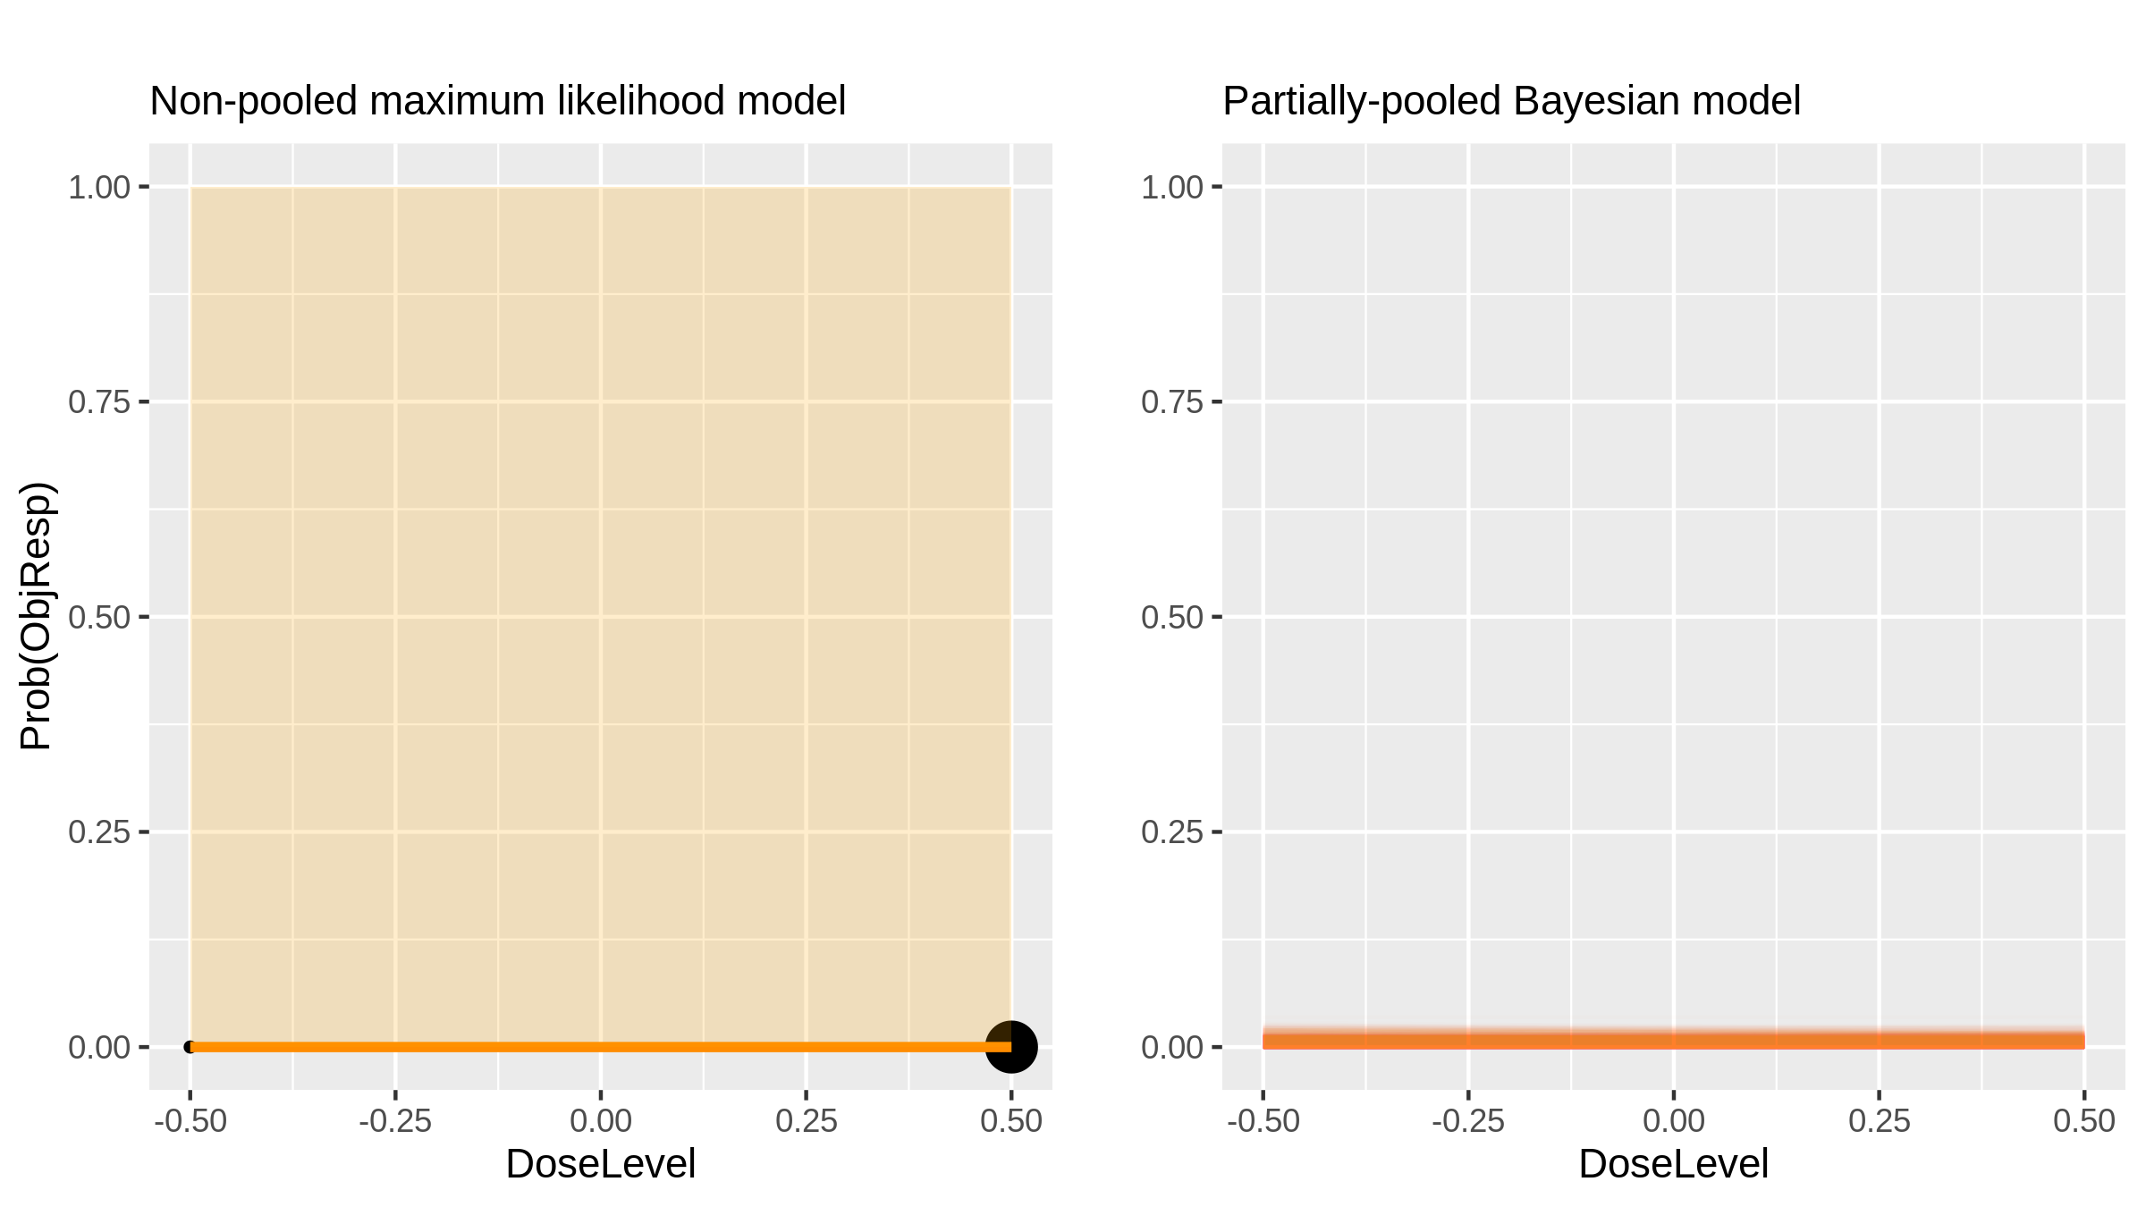
MK-0751 (Inhibitor) in Cns Tumours [Fouladi2011_1]

Slide 33
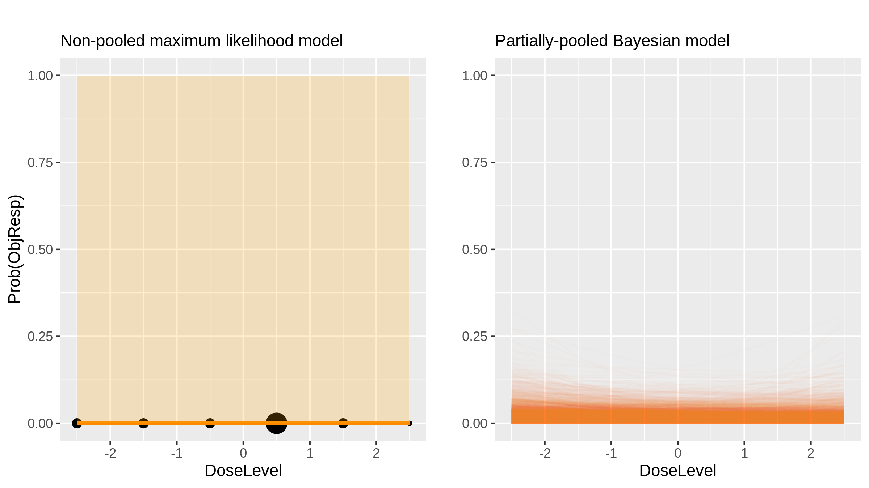
Ixabepilone (Chemotherapy) in Glioma [Peereboom2010_1]

Slide 34
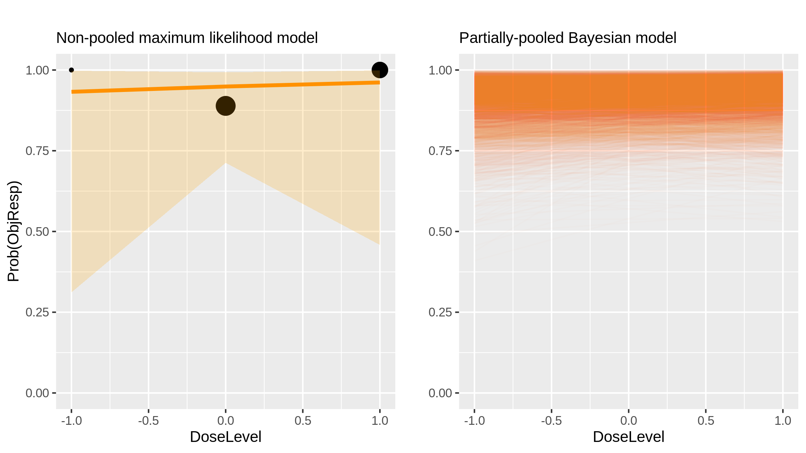
Bortezomib (Inhibitor) in Lymphoma [Furman2010_1]

Slide 35
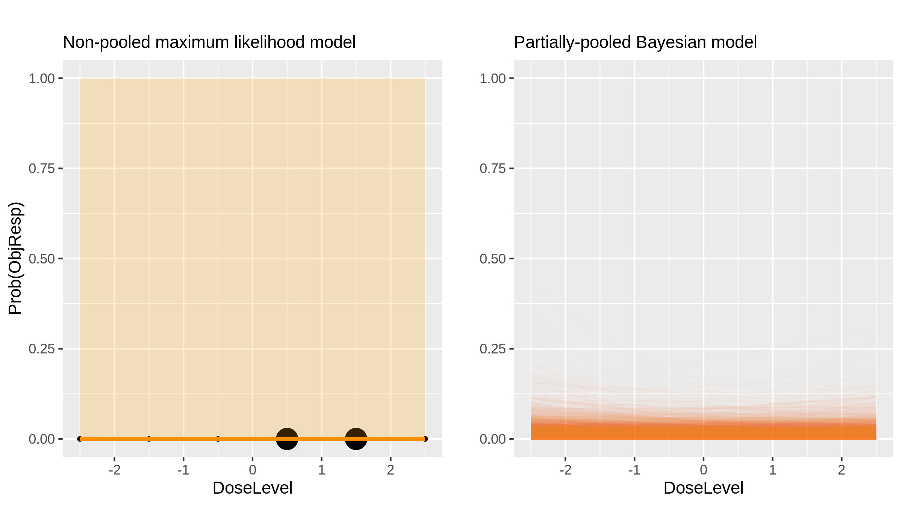
Lapatinib (Inhibitor) in Cns Tumours [Fouladi2010_1]

Slide 36
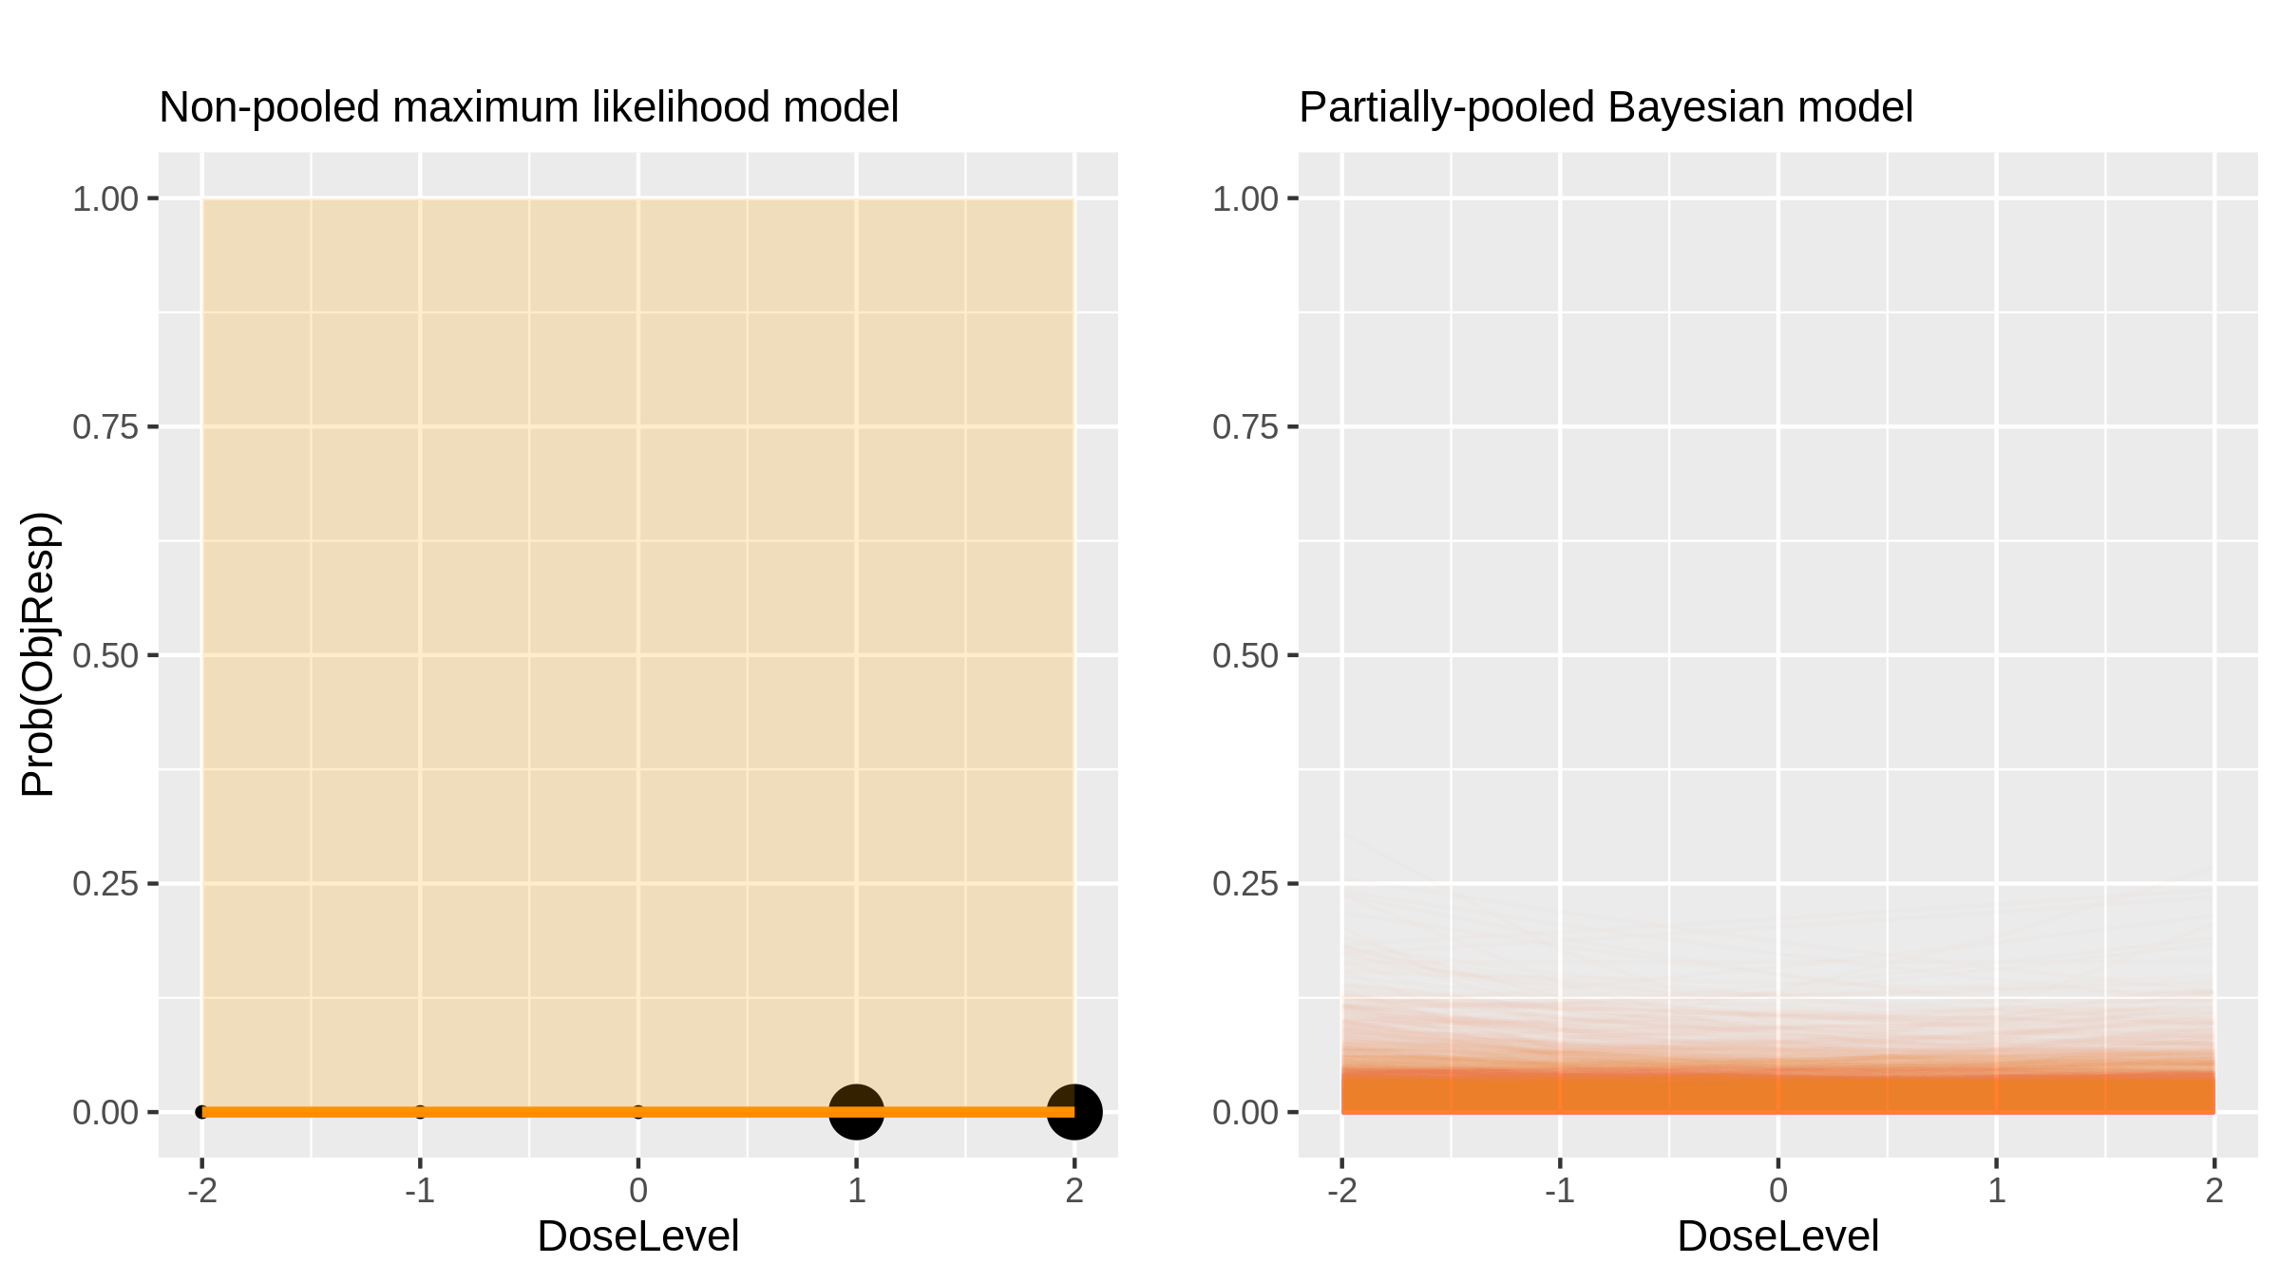
Lapatinib (Inhibitor) in Cns Tumours [Fouladi2010_2]

Slide 37
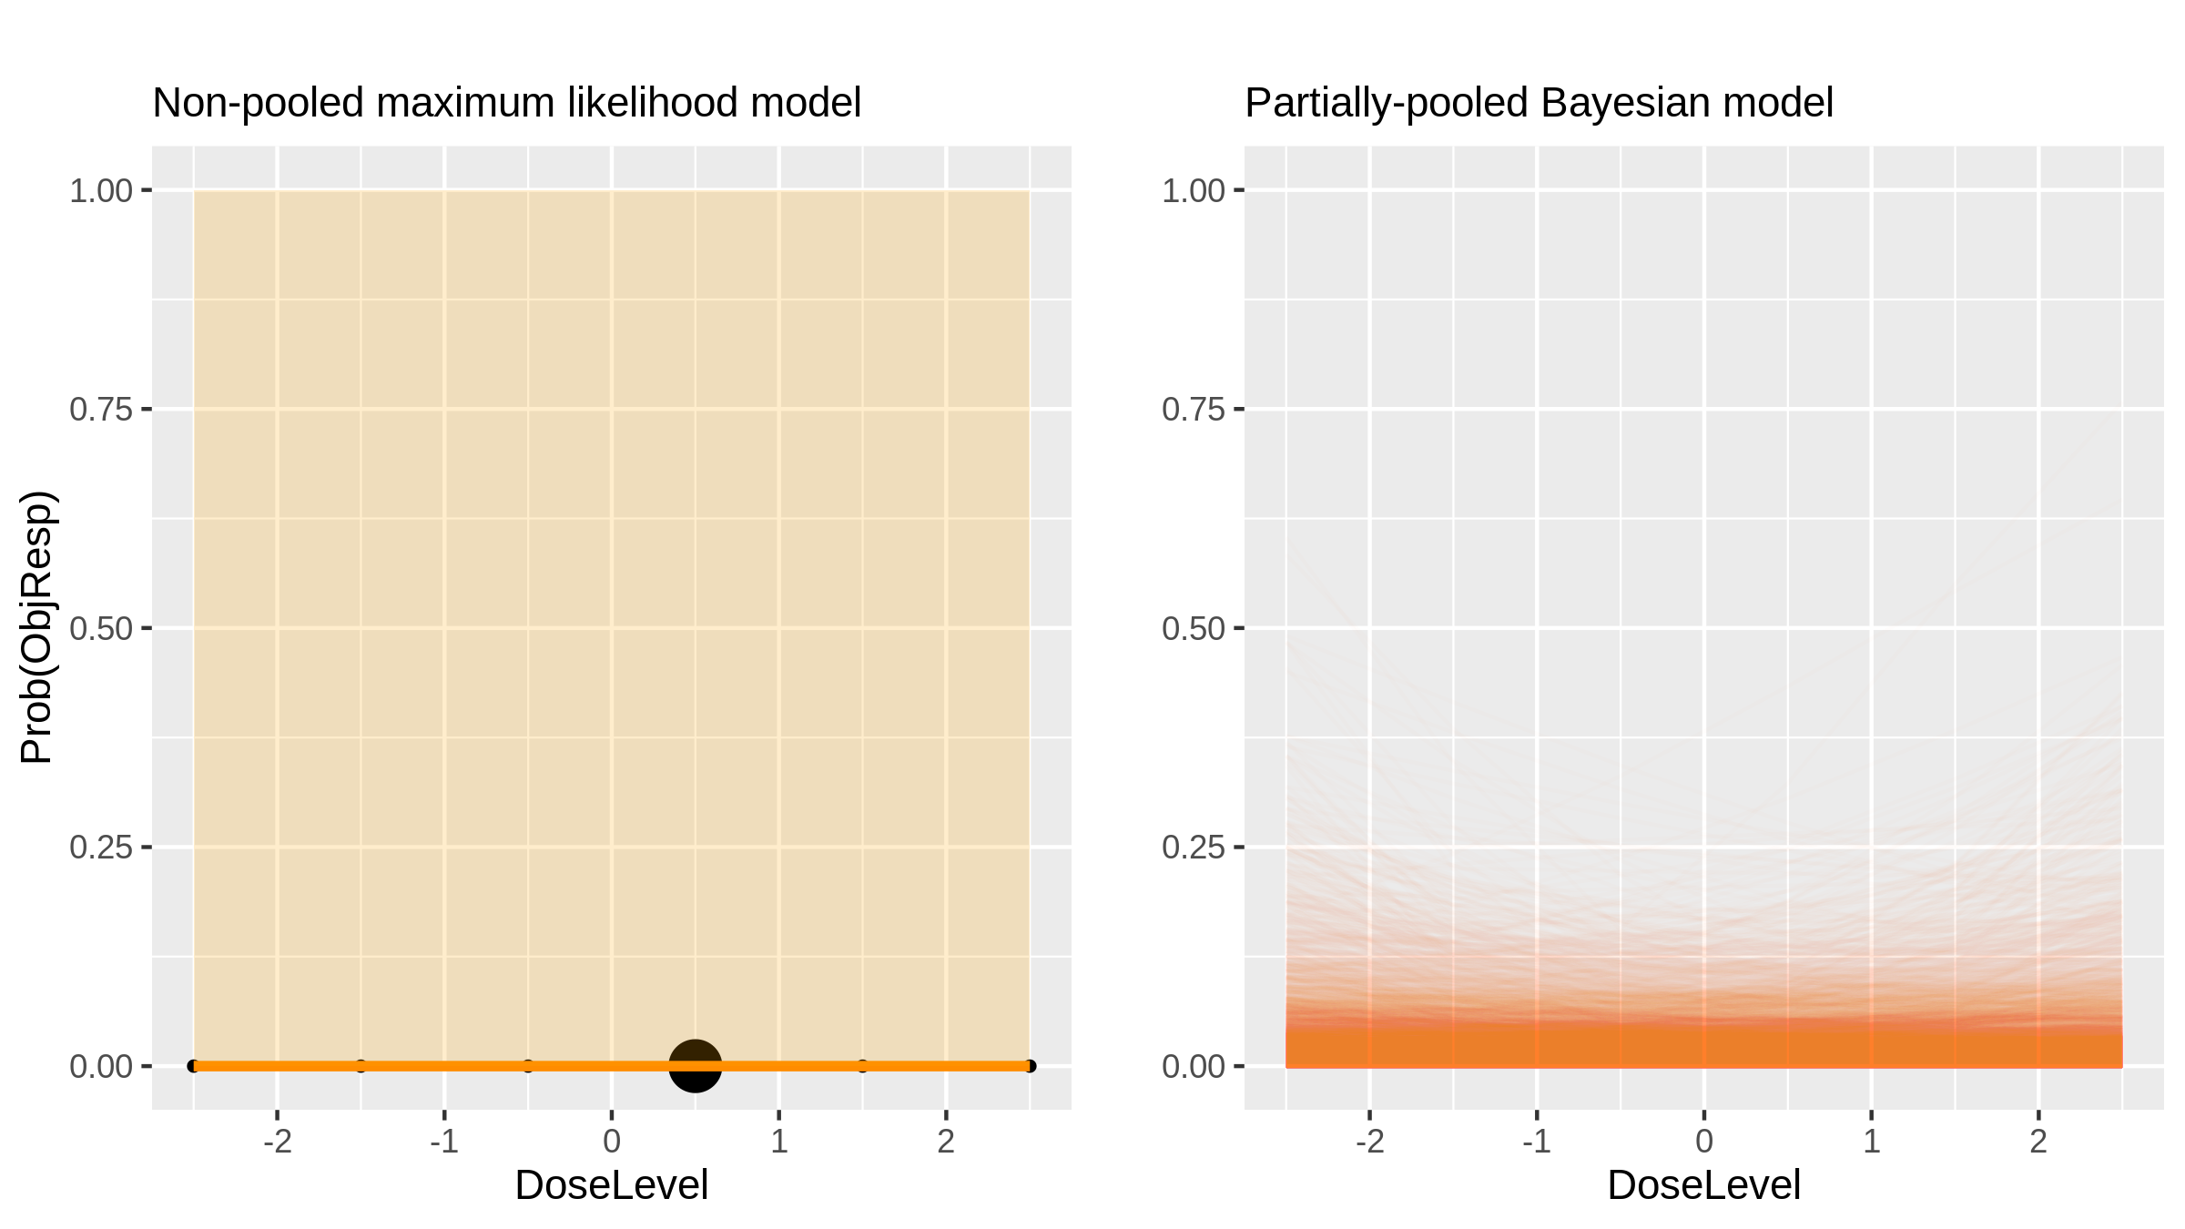
¹⁵³Sm-EDTMP (Radiotherapy) in Osteosarcoma [Loeb2009_1]

Slide 38
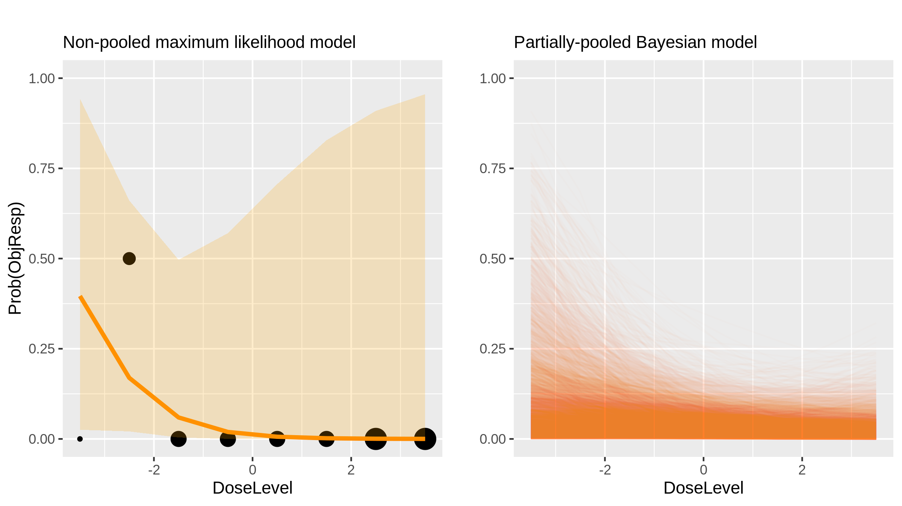
H103 (Cell therapy) in Advanced Solid Tumours [Li2009_1]

Slide 39
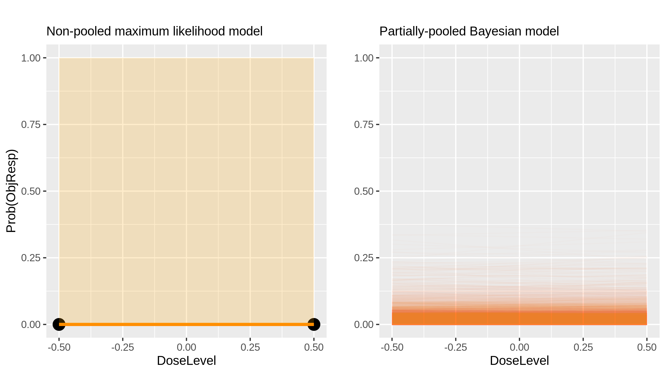
Nilotinib + Imatinib (Inhibitor) in Gastrointestinal Cancer [Demetri2009_1]

Slide 40
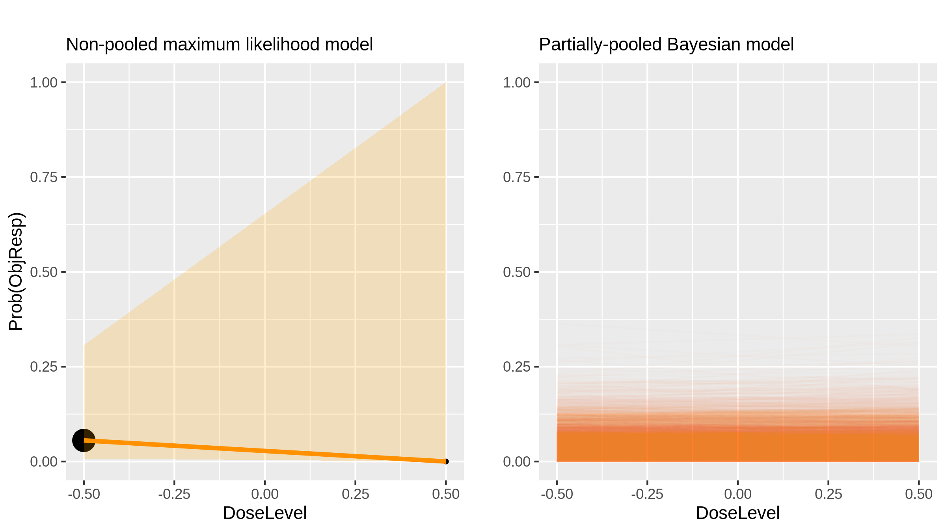
Nilotinib + Imatinib (Inhibitor) in Gastrointestinal Cancer [Demetri2009_1]

Slide 41
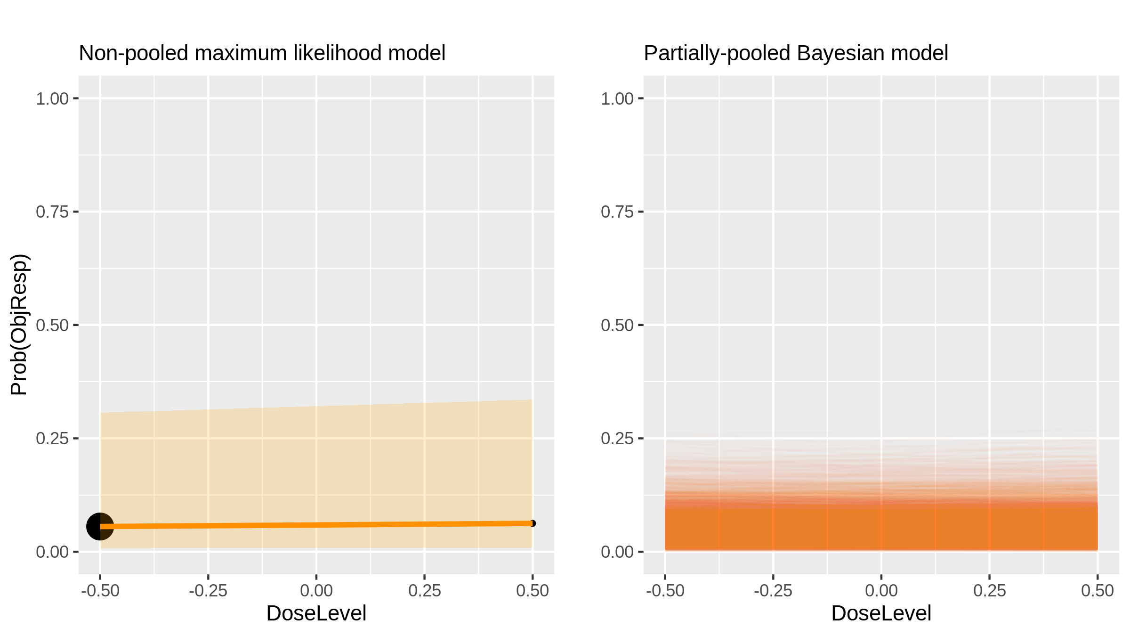
Nilotinib + Imatinib (Inhibitor) in Gastrointestinal Cancer [Demetri2009_1]

Slide 42
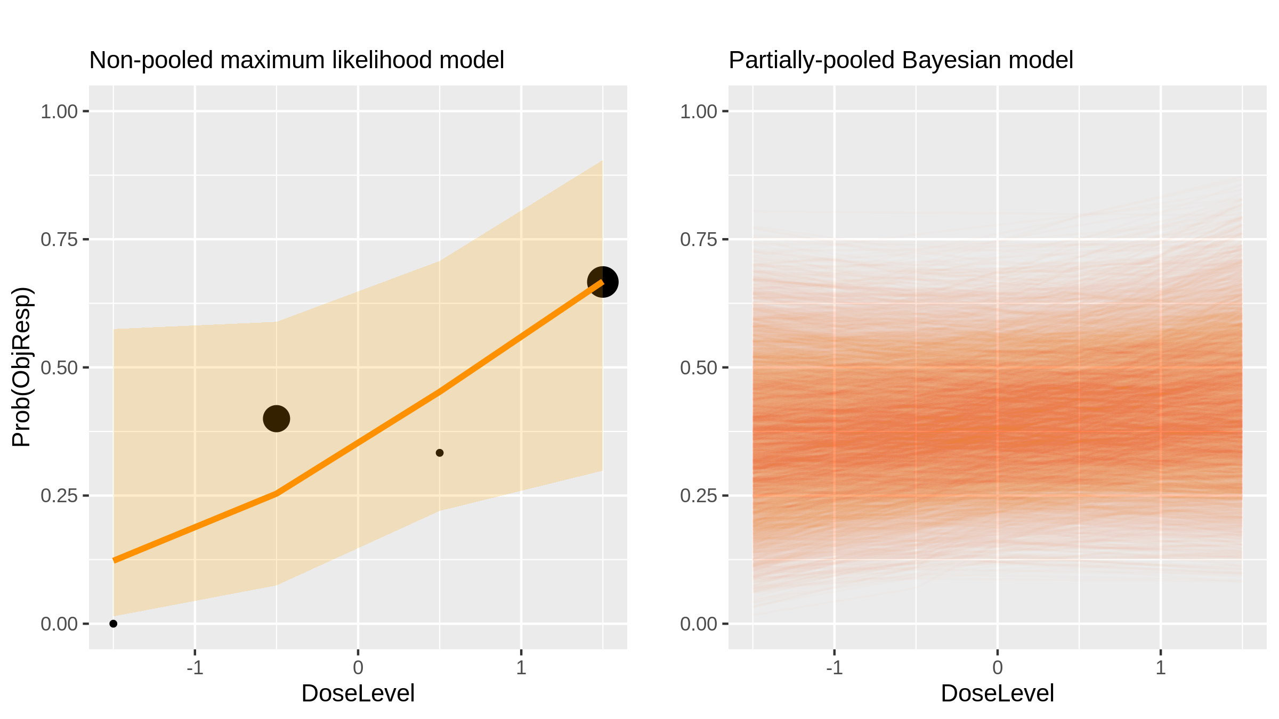
Epirubicin + capecitabine (Chemotherapy) in Breast Cancer [Saji2008_1]

Slide 43
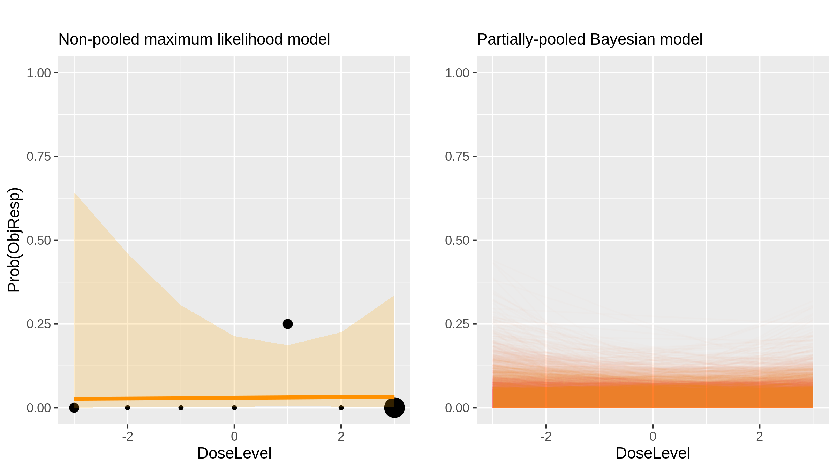
Cilengitide (Inhibitor) in Brain Cancers [MacDonald2008_1]

Slide 44
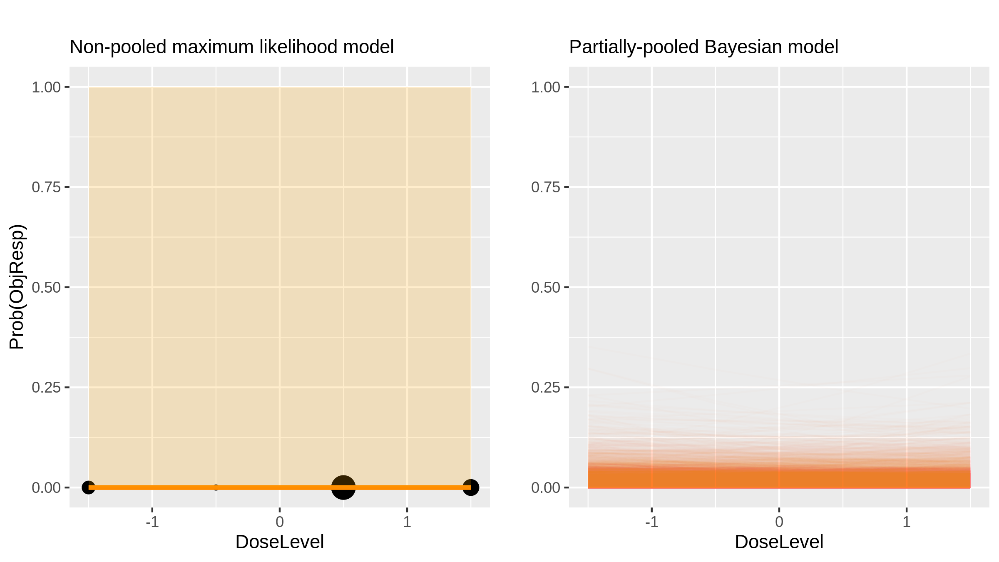
Rapamycin (Inhibitor) in Solid Tumours [Jimeno2008_1]

Slide 45
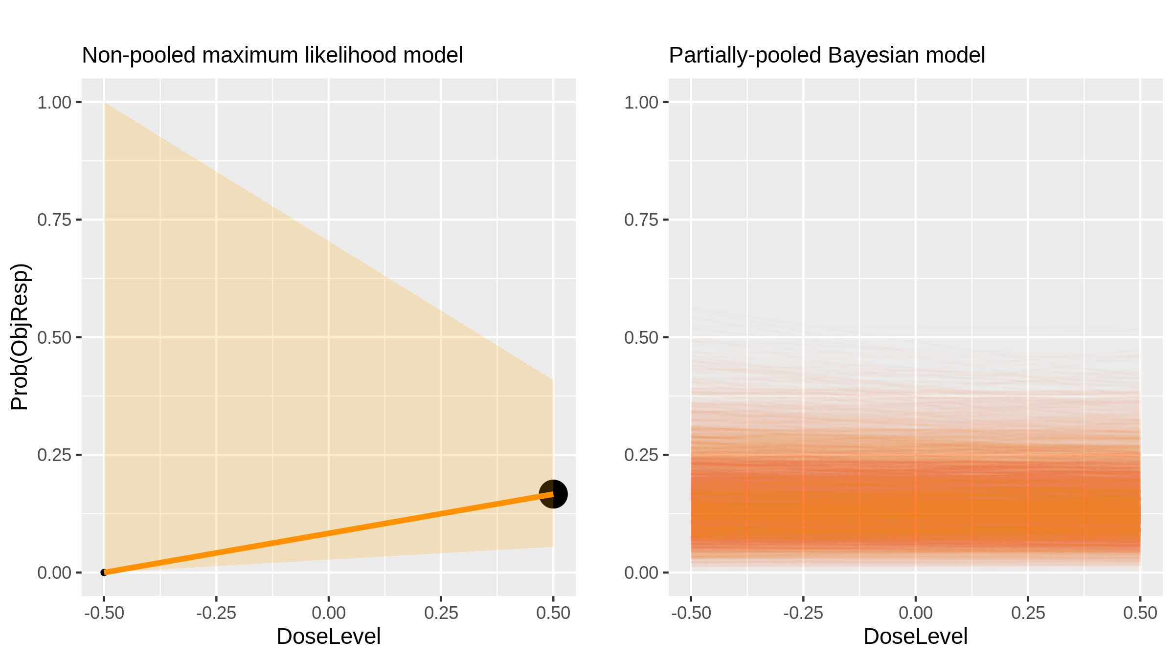
Temozolomide (Chemotherapy) in Melenoma [Guillot2008_1]

Slide 46
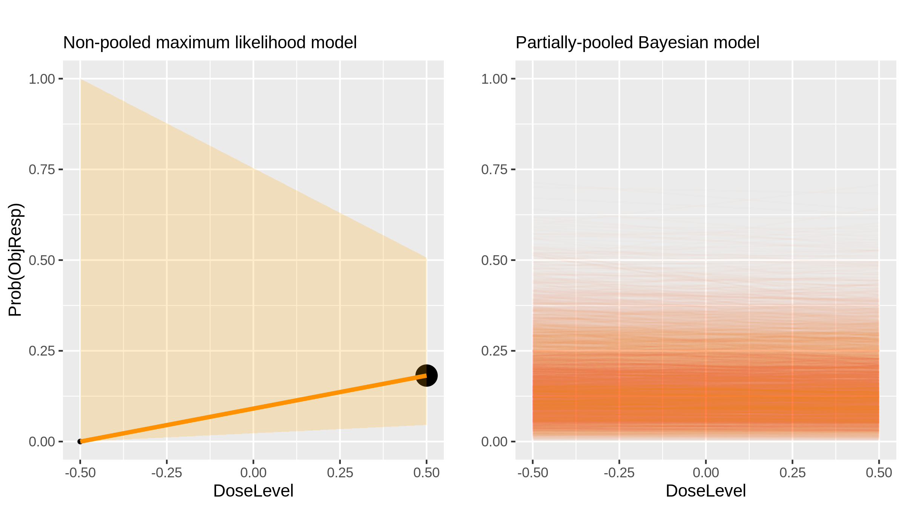
Temozolomide (Chemotherapy) in Melenoma [Guillot2008_1]

Slide 47
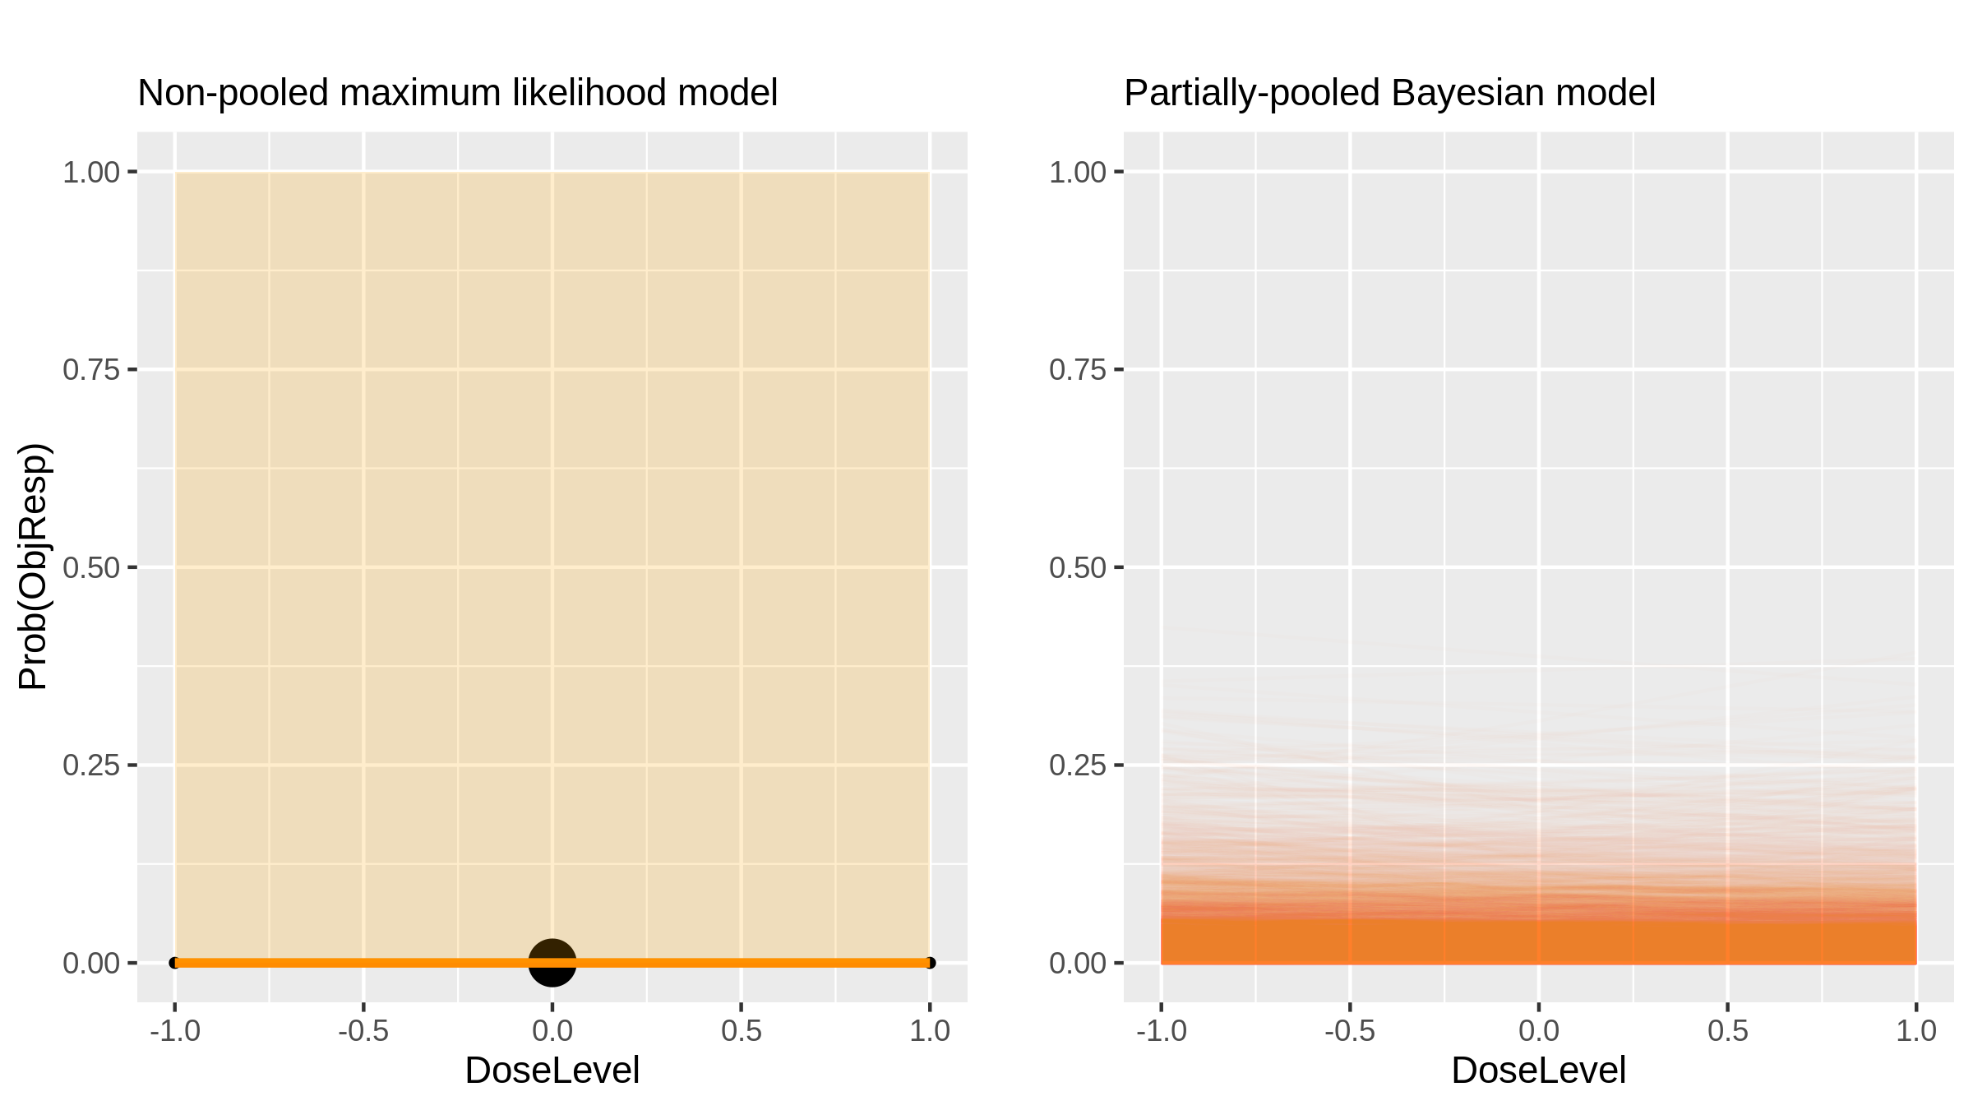
Karenitecin (Chemotherapy) in Glioma [Grossman2008_1]

Slide 48
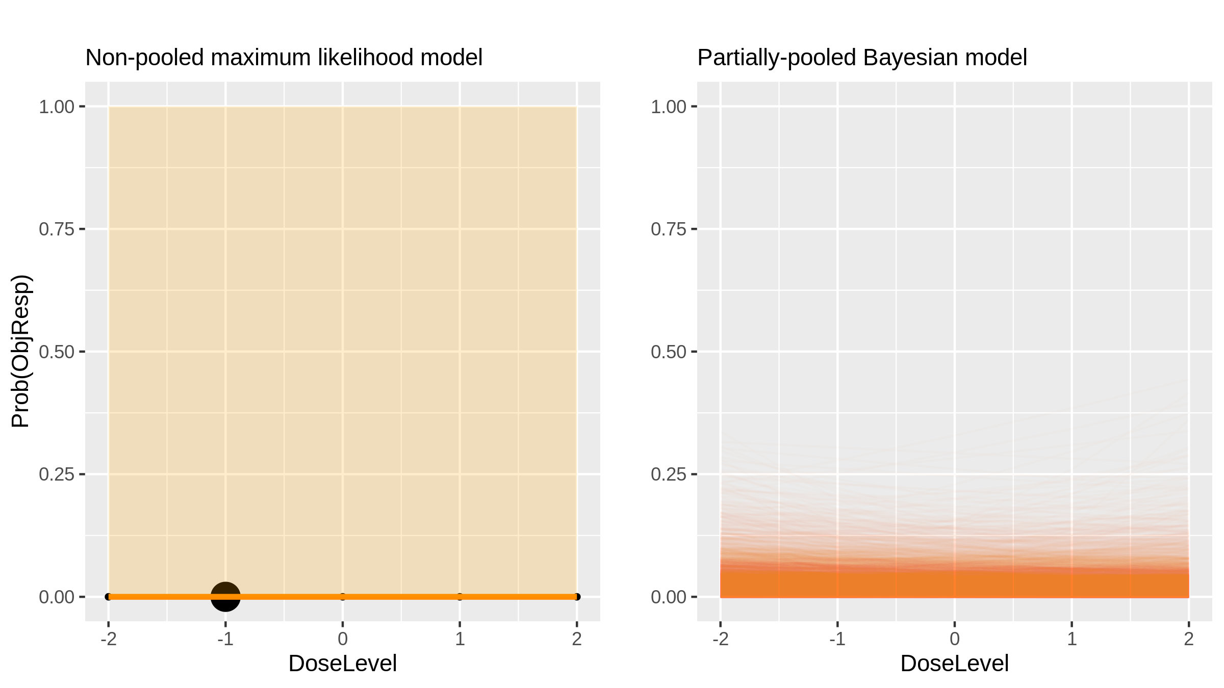
Karenitecin (Chemotherapy) in Glioma [Grossman2008_2]

Slide 49

LAQ824 (Chemotherapy) in Advanced Solid Tumours [DeBono2008_1]

Slide 50
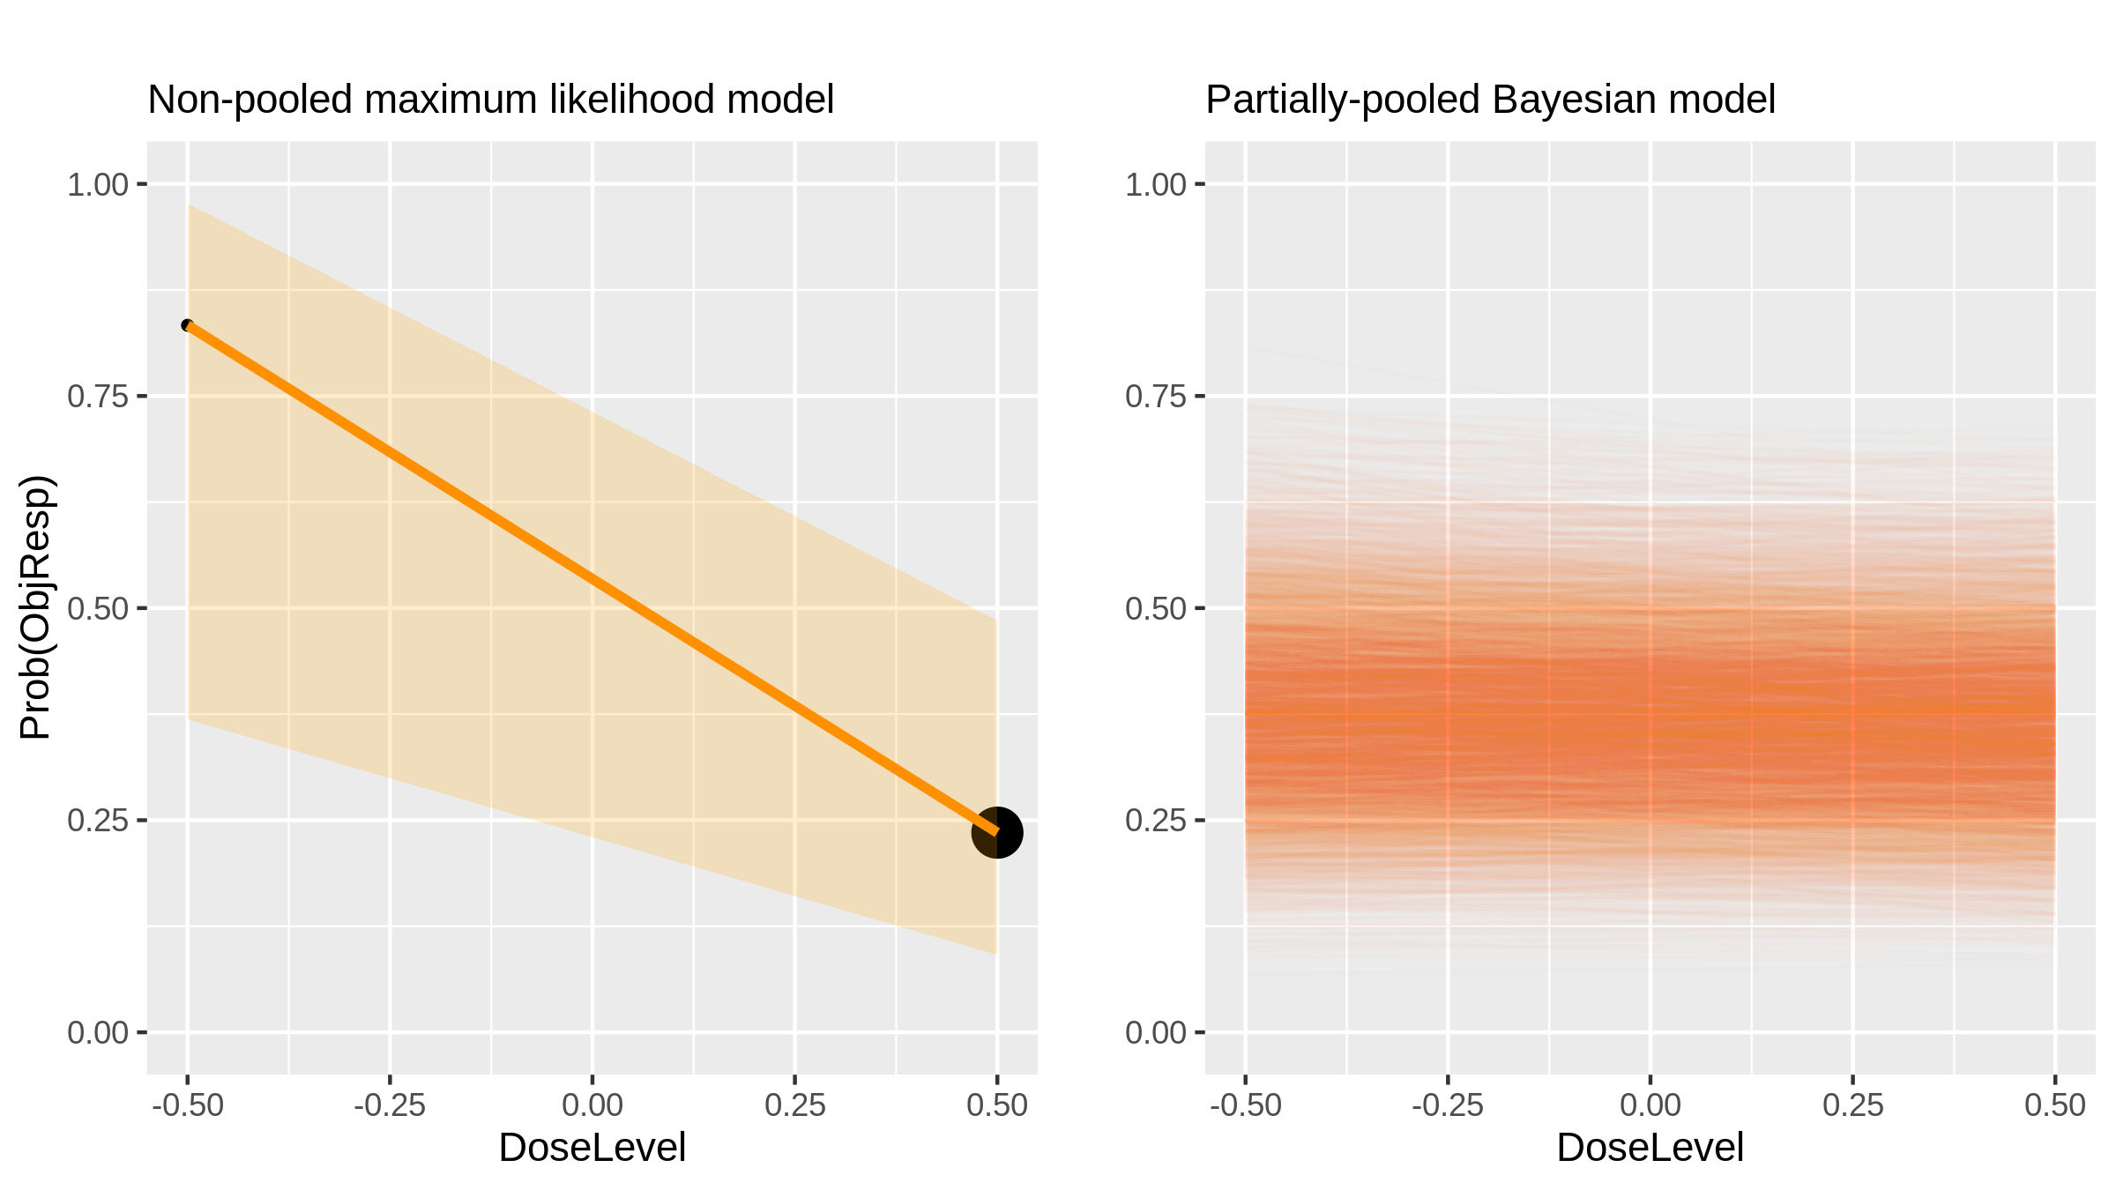
Everolimus (Inhibitor) in Breast Cancer [Andre2010_1]

Slide 51
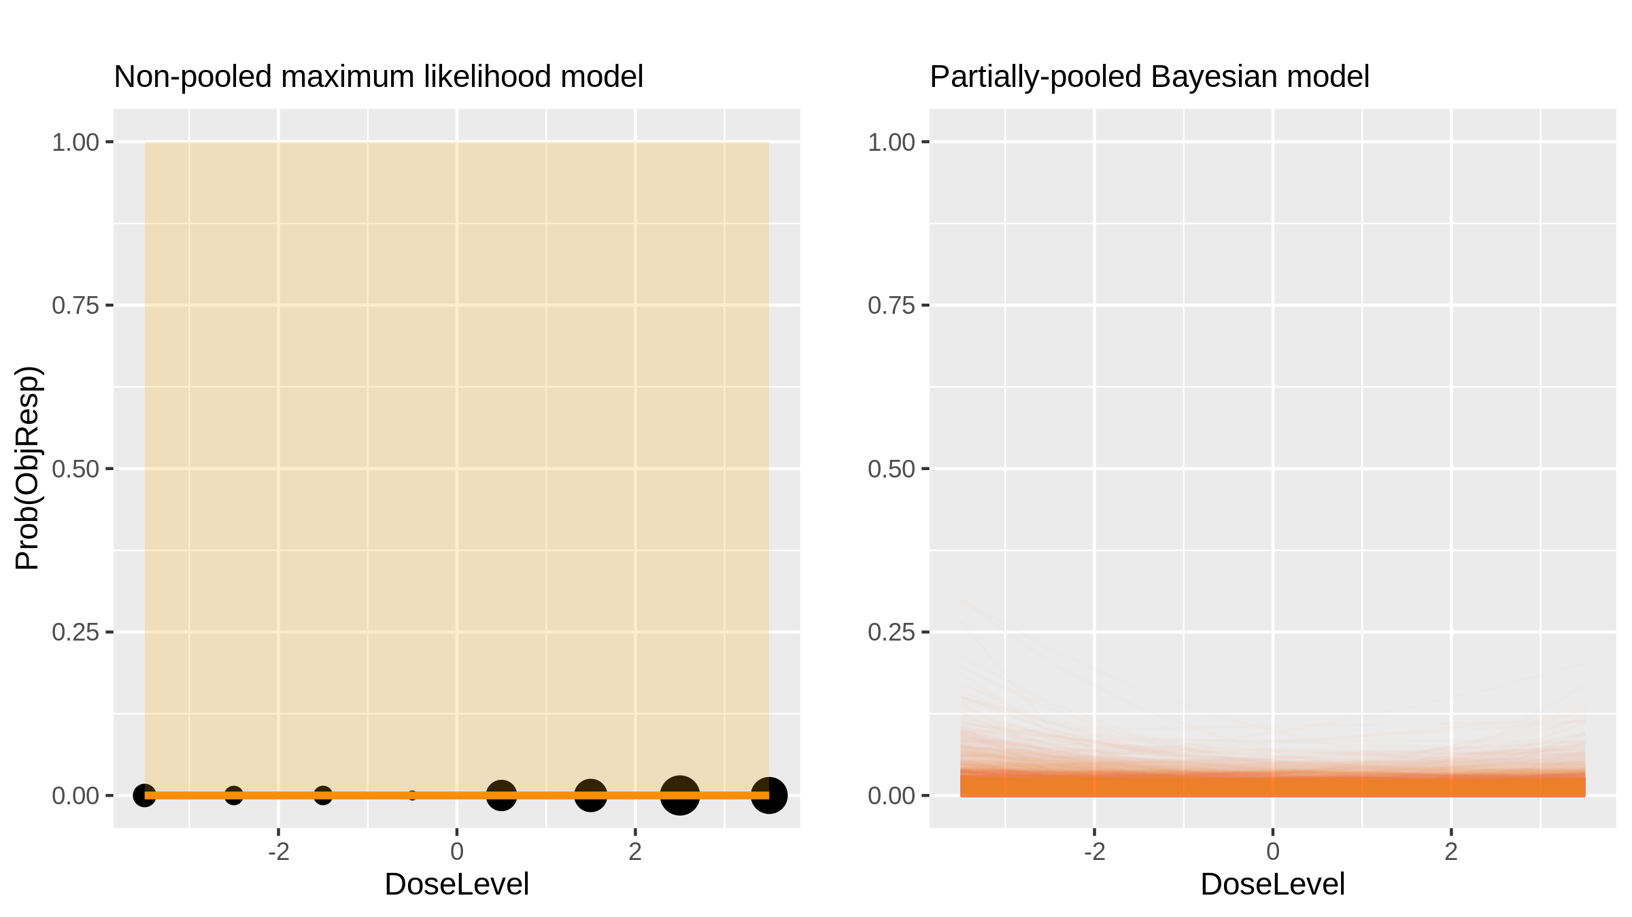
BGT226 (Inhibitor) in Advanced Solid Tumours [Markman2012_1]

Slide 52
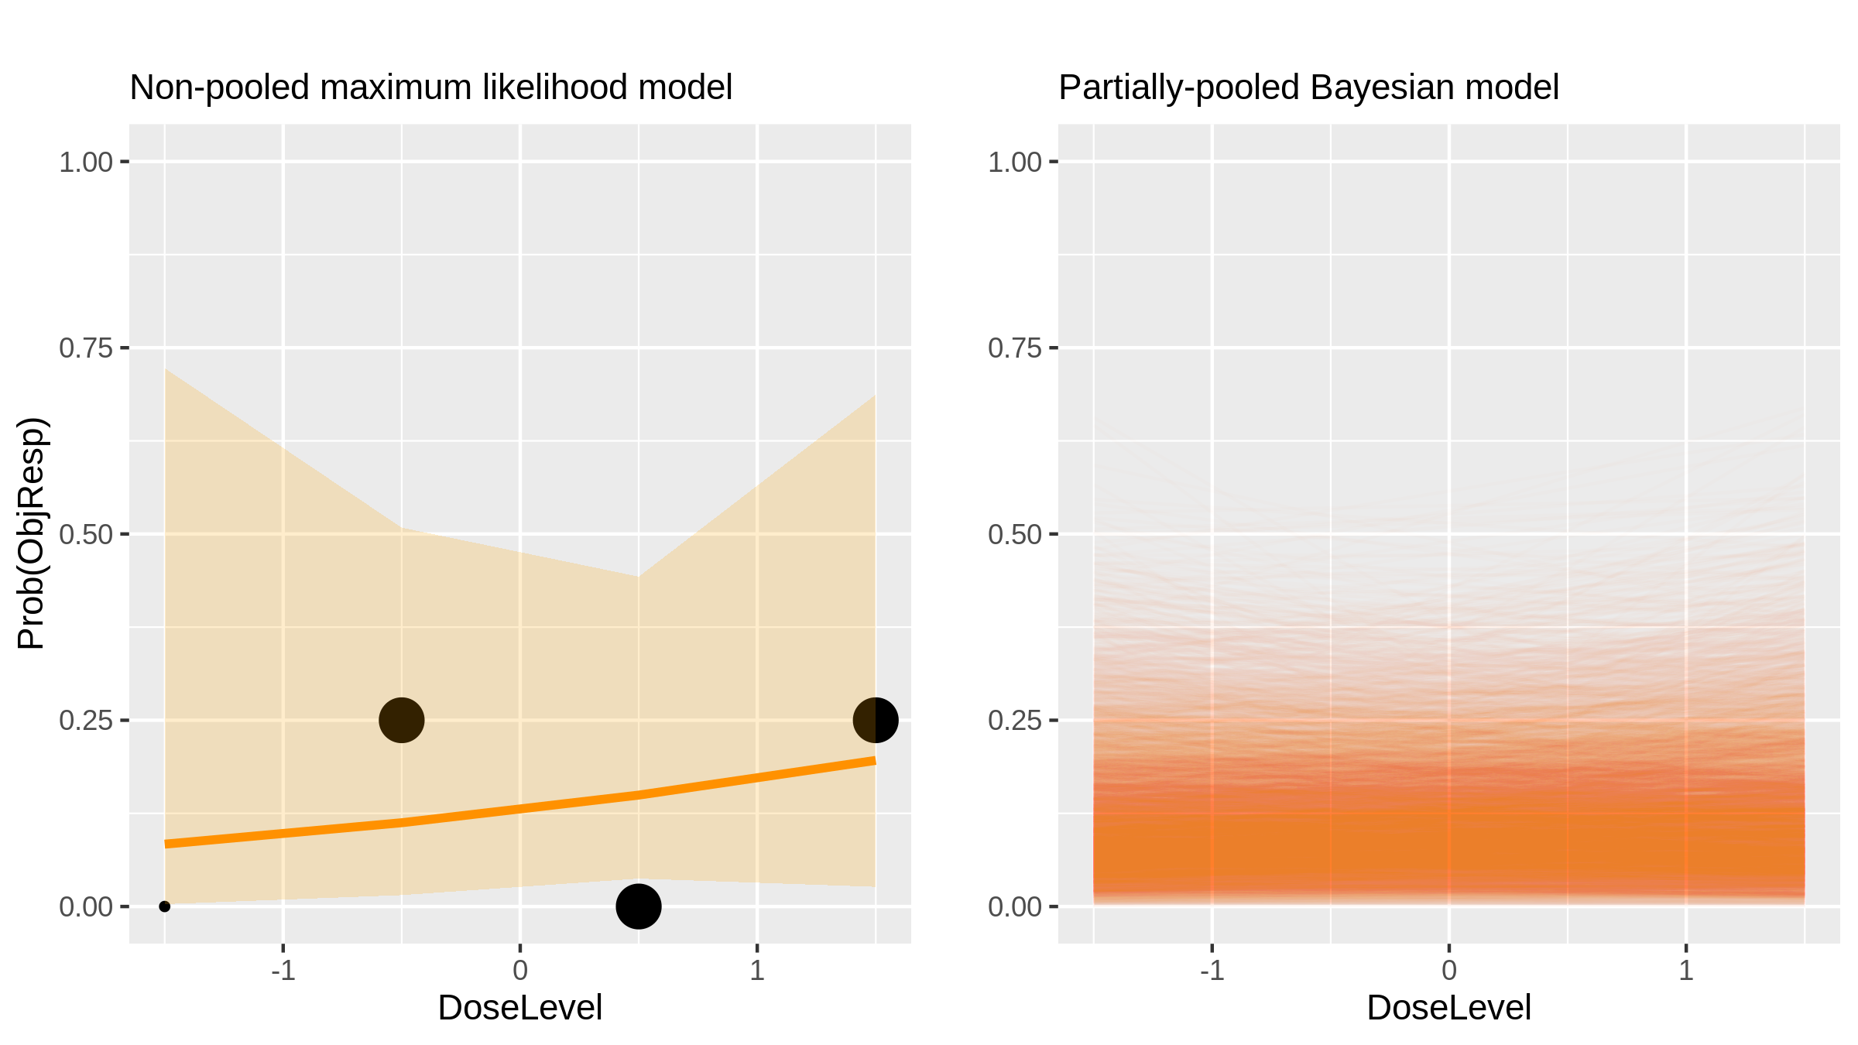
Neratinib (Inhibitor) in Solid Tumours [Gandhi2014_1]

Slide 53

Neratinib (Inhibitor) in Solid Tumours [Gandhi2014_1]

Slide 54

Neratinib (Inhibitor) in Solid Tumours [Gandhi2014_1]

Slide 55

Neratinib (Inhibitor) in Solid Tumours [Gandhi2014_1]

Slide 56

Clofarabine (Chemotherapy) in Aml [Foster2012_1]

Slide 57

Everolimus (Inhibitor) in Breast Cancer [Jerusalem2011_1]

Slide 58

Samarium 153 + Bortezomib (Radiopharmaceutical + Inhibitor) in Multiple Myeloma [Berensen2009_1]

Slide 59

Samarium 153 + Bortezomib (Radiopharmaceutical + Inhibitor) in Multiple Myeloma [Berensen2009_1]

Slide 60

Oxaliplatin + Flurouracil (Chemotherapy) in Oesophageal Cancer [Conroy2008_1]

Slide 61

Docetaxel + cisplatin (Chemotherapy) in Oesophageal Cancer [Day2011_1]

Slide 62

Chidamide (Chemotherapy) in Advanced Solid Tumours [Dong2012_1]

Slide 63

Chidamide (Chemotherapy) in Advanced Solid Tumours [Dong2012_1]

Slide 64

Reovirus (Oncolytic virus) in Glioma [Forsyth2008_1]

Slide 65

BI2356 (Inhibitor) in Advanced Solid Tumours [Frost2012_1]

Slide 66

Vorinostat (Chemotherapy) in Aml [Gojo2013_1]

Slide 67

AZD4877 (Inhibitor) in Aml [Kantarjian2012_1]

Slide 68

Docetaxel (Chemotherapy) in Melanoma [Kim2009_1]

Slide 69

Ad5-Δ24-RGD (Oncolytic virus) in Gynaecological Cancer [Kimball2010_1]

Slide 70

Ixabepilone (Chemotherapy) in Advanced Solid Tumours [Kunz2012_1]

Slide 71

Sunitinib, capecitabine, cisplatin (Chemotherapy + inhibitor) in Gastric Cancer [Lee2013_1]

Slide 72

Sunitinib, capecitabine, cisplatin (Chemotherapy + inhibitor) in Gastric Cancer [Lee2013_1]

Slide 73

Sunitinib, capecitabine, cisplatin (Chemotherapy + inhibitor) in Gastric Cancer [Lee2013_1]

Slide 74

TAK-285 (Inhibitor) in Advanced Solid Tumours [LoRusso2014_1]

Slide 75

TAK-285 (Inhibitor) in Advanced Solid Tumours [LoRusso2014_1]

Slide 76

Flavopiridol + doxorubicin (Chemotherapy + inhibitor) in Sarcoma [Luke2012_1]

Slide 77

Flavopiridol + doxorubicin (Chemotherapy + inhibitor) in Sarcoma [Luke2012_1]

Slide 78

Gemcitabine + sunitinib (Chemotherapy + inhibitor) in Advanced Solid Tumours [Michaelson2013_1]

Slide 79

Gemcitabine + sunitinib (Chemotherapy + inhibitor) in Advanced Solid Tumours [Michaelson2013_1]

Slide 80

E7820 (Inhibitor) in Advanced Solid Tumours [Mita2011_1]

Slide 81

Panobinostat and Everolimus (Chemotherapy + inhibitor) in Lymphoma [Oki2013_1]

Slide 82

Lenalidomide (Immunomodulatory drug) in Aml [Pollyea2012_1]

Slide 83

Cytarabine (Chemotherapy) in Aml [Rao2012_1]

Slide 84

Thalidomide/docetaxel (Immunomodulatory drug + chemotherapy) in Advanced Solid Tumours [Sanborn2008_1]

Slide 85

Thalidomide/docetaxel (Immunomodulatory drug + chemotherapy) in Advanced Solid Tumours [Sanborn2008_1]

Slide 86

Foretinib (Inhibitor) in Advanced Solid Tumours [Shapiro2013_1]

Slide 87

Clofarabine (Chemotherapy) in Lymphoma [Srivastava2011_1]

Slide 88

Darinaparsin (Chemotherapy) in Advanced Solid Tumours [Tsimberidou2009_1]

Slide 89

Nedaplatin (Chemotherapy) in Cervical Cancer [Yamamoto2009_1]

Slide 90

Brentuximab Vedotin (Monoclonal Antibody) in Lymphoma [Younes2010_1]

Slide 91

GM-CSF + IL-2 + IFN-α (Cytokine) in Rcc [Garcia2012_1]

Slide 92

Etoposide (Chemotherapy) in Aml [Saraiya2008_1]

Slide 93

Temsirolimus (Inhibitor) in Advanced Solid Tumours [Spunt2011_1]

Slide 94

Cisplatin (Chemotherapy) in Head & Neck Scc [Yu2010_1]

